Slide 1
Overview of methods used to predict changes in the world of work
Aleksandra Djurovic
Belgrade Open School team​​
This license lets you (or other party) share, remix, transform, and build upon this material non-commercially, as long as you credit the Connect! project partners and license your new creations under identical terms.

Slide 2
- Dimensions of impact of different trends to world of work - Overview of some of the trends that impact the world of work and their possible implications to number of jobs and job quality
What we talked about in Learning Session 1
Accelerating pace of technological change
01
Shifting demographic patterns
02
Globalization
03
Climate change
04
COVID-19 pandemic
05

Slide 3
Aims of the presentation
1
To describe methods used to determine changes in the world of work
2
To reflect on findings on the challenges in the world of work taking into account methods that were applied

Slide 4
Overview of the Learning Session 2
What are some of the methods used to forecast changes in the world of work?
What are their advantages and disadvantages?
Examples of use of different methods
How to assess credibility of information on the changes in the world of work?

Slide 5
There are a lot of information on trends in the world of work.
How much of this we should question?
How to know what information is credible?
connect-erasmus.eu
Notes:
Naslovi u pozadini

Slide 6
To assess the information on the changes in the world of work it is important to understand methods used to capture and understand the changes that are taking place.
Various methods are being used to predict changes, to understand which occupations will grow in the future, which jobs and tasks are more likely to be affected by digitalization and automation and what skills will be most in demand.

Slide 7
Some of the methods and approaches that are being used to predict trends in the world of work…
QUANTITATIVE METHODS | QUALITATIVE METHODS
Mechanistic/extrapolative techniques More complex time series models Behavioural/econometric models Surveys | Delphi techniques (expert opinion/consultation) Case studies Focus groups Scenario planning

Slide 8
Using mathematical models to predict trends
Forecasting is done by developing a ‘mathematical model’ through (1) collecting longtime series data of past trends in economy, labour market, demography, education, etc. (2) making assumptions on the future of economy, labour market, demography, education.
Models are often built using statistical and econometric techniques on data drawn from largely official sources.
Forecast models can vary according to the methodological approach adopted. Qualitative methods can be used together with quantiative methods in forecasts.
Source: https://www.etf.europa.eu/sites/default/files/m/B7B61B2538FFF764C12580E600495140_Skills%20forecasts.pdf

Slide 9
Quantitative modelling
Basic methods for quantitative modelling aiming to find patterns in available data that can be used to predict its future path can be classified as:
(a) extrapolation of past trends which is often used where only very limited time series information is available;
(b) more complex time series methods which are used where more time series observations are available, the aim is to find patterns in a time series;
(c) behavioural analysis which is an attempt to provide some understanding of how the patterns in available data have arisen and why they may change in the future, using understanding from disciplines such as economics, sociology and psychology of what influences the behaviour of the key actors in the economy

Slide 10
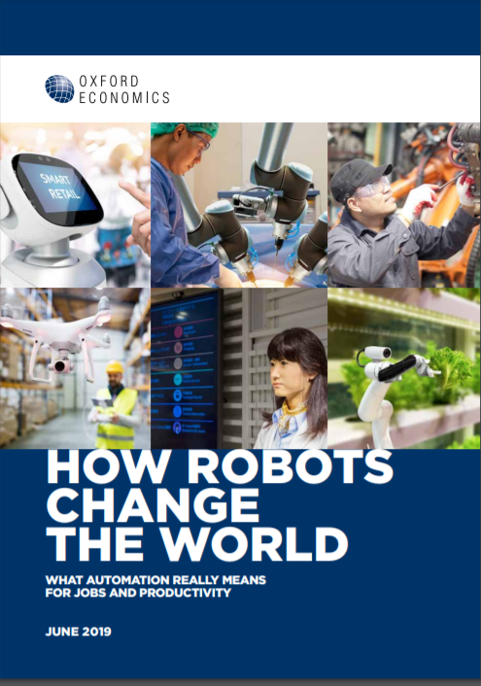
Quantitative modelling - example
The quantitative modelling was focused on industrial robots used in all types of manufacturing around the world for physical activities in production (for example processing materials - laser cutting and mechanical grinding) to asses the impact of robots on employment and productivity levels.
The modelling was based on data on robot investment in Japan, the European Union, the United States, South Korea, and Australia over the period from 1994 to 2014. It was based on yearly surveys of robot suppliers.
One of the models used in the analysis isolates the impact of robot density (robots per 1,000 workers) on the manufacturing employment-to-population ratio in each region and year, having controlled for variables such as economic performance (GDP per capita), globalisation (trade with China, trade with the rest of the world) and wage levels (compensation per capita).

Slide 11
The Delphi method “a method for structuring a group communication process so that the process is effective in allowing a group of individuals, as a whole, to deal with a complex problem“ (Häder and Häder, 1995)
It is particularly used by experts in a series of iterative learning rounds
Delphi first establishes the group’s initial view, presents instant feedback on differing opinions, and seeks an agreed position in the final round. Contributors to the group analysis do not have to meet in person and can see the results as they, and their colleagues, add their views in real time
At the beginning, the organiser formulates questions about the future and presents these to the contributors. Contributors respond by adding their rankings and comments. The organisers then modify the anonymous comments received to formulate better questions.
The process is run again, in a series of rounds, until a consensus answer is arrived at (Jackson, 2013, Section 3.7)

Slide 12
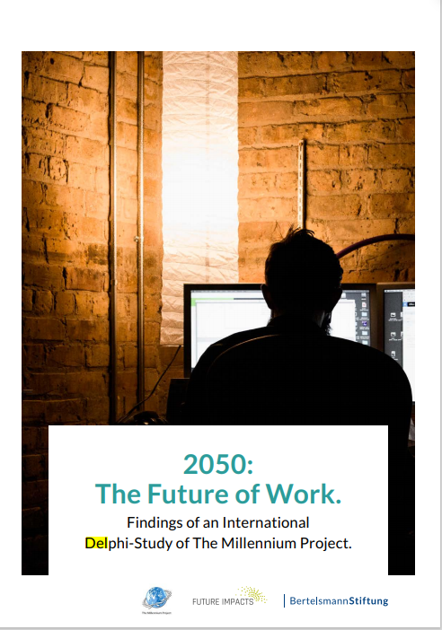
The Delphi method - example
The aim was to identify the major themes in the field of future work which we must address to arrive at solutions
A total of 298 people participated, identified as the leading experts from the academic and business context
They answered set of predefined questions. For example, one of them was formulated like this: More jobs were created than replaced during both the Industrial and Information Age. How ever, many argue that the speed, integration and globalisation of technological changes of the next 35 years (by 2050) will cause massive structural unemployment. What are the technologies or factors that might make this true or false?
Respondents could give free-ranging answers to each of the questions and make general comments.
The next step was drafting road maps and scenarios based on the findings and then seeking feedback of participating experts on them

Slide 13
Focus groups „a research technique that collects data through group interaction on a topic determined by the researcher“ (Morgan, 1996)
Collective conversation on a particular issue, generally involving 6-8 people
It is used to find out efficiently about a range of people’s thoughts and experiences and sources of complex behaviours -> to identify a range of experiences and thoughts

Slide 14
Focus groups - example
The main research question asked was in what ways are secondary school subject-choice systems, and students’ subject choices, positioned to respond to future of work trends?
Two focus group discussions were held. Six participants attended the first one, and seven participants attended the second one. All participant were senior leaders at their school and they represented a diverse range of schools.

Slide 15
Scenario planning a systemic method for thinking creatively about possible complex and uncertain futures
Central idea of scenario planning is to consider a variety of possible futures that include many of the important uncertainties in the system rather than to focus on the accurate prediction of a single outcome
The scenario method is also often used within quantitative forecasting projects to analyse and describe the outcomes of a skills forecast.
The main contribution of this method is helping the decision-makers to consider possible options and to choose the preferred vision for future policy decision

Slide 16
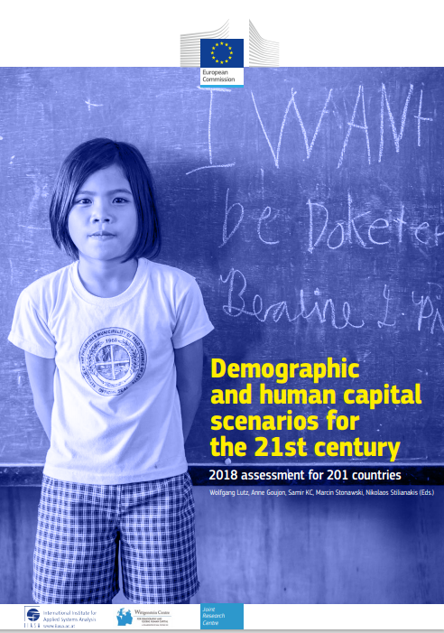
Scenario method - example
The purpose of contrasting scenarios was to inform the assessment of global population scenarios by age, sex and level of educational attainment
Contrasting scenarios were based on the most recent demographic data, analyses and trajectories in 201 countries and they covered key population and human capital factors
They were combined with different scenarios of labour force participation to assess impact of demografic changes to the world of work

Slide 17
Discuss advantages and disadvantages of using different methods for predicting changes in the world of work and list them in the table in the provided template.

Slide 18
Each method has its advantages and disadvantages…
Method | Advantages | Disadvantages
Quantitative forecasting models | Comprehensive Consistent Transparent an explicit Measureable | Requires reliable and consistent time series on labour markets and population Costly Not everything is quantifiable May give false impression of precision
Focus groups, round tables, Expert workshops, expert opinion surveys and Delphi style methods | Holistic Direct user involvement May be able to address problems in greater depth Useful mechanisms for exchanging views | May be non-systematic May be inconsistent May be subjective May be nonrepresentative and provide a partial view May be anecdotal, not grounded in reality
Foresights and scenario development | Holistic Direct user involvement May be able to address problems in greater depth Useful mechanisms for exchanging views Takes into account uncertainties for the future | May be non-systematic May be inconsistent May be subjective
Source: https://www.ilo.org/wcmsp5/groups/public/---dgreports/---inst/documents/publication/wcms_646143.pdf

Slide 19
How to assess quality of sources of information on the changes in the world of work?

Slide 20
USU Libraries, Source evaluation
https://www.youtube.com/watch?v=Tscm0fcb9CM

Slide 21
When evaluating sources on changes in the world of work take into account…
Rationale
Why did the author make this information available?
Authority
What are the author's credentials?
Date
When was the information published or last updated? Have newer articles been published on your topic?
Accuracy
Do the citations and references support the author's claim? Is there general agreement among subject experts? Does the method seem appropriate and well-executed?
Relevance
Does the source add something new to your knowledge of the topic?
connect-erasmus.eu

Slide 22
47% of all persons employed in the US are currently working in jobs that could be performed by computers and algorithms within the next 10 to 20 years
Often cited finding

Slide 23
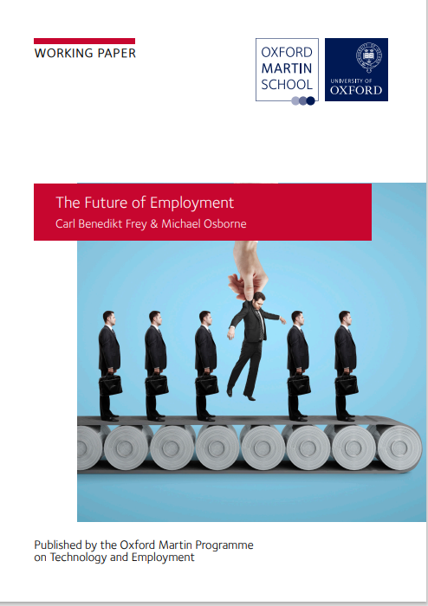
If we evaluated this source…
Rationale - To bridge the gap in literature – at the moment of writing the study there was no research that had quantified what technological progress was likely to mean for the future of employment
Authority - Frey & Osborne, University of Oxford
Date - It was published in 2013, there are newer research on this topic, including new research studies by the authors of this study

Slide 24
If we evaluated this source…
Accuracy - There is no agreement between the experts on this topic. Method relies on subjective assessments of the potential for occupations to be fully automated. The authors emphasized that they made no attempt to estimate how many jobs will actually be automated, which depend on many other things
Relevance - It is highly relevant source for understanding changes in the world of work, but its findings must be put in the context of aims, methods and limitations, as well as more recent findings

Slide 25
References
International Labour Office & Organisation for Economic Co-operation and Development.(2018). Approaches to anticipating skills for the future of work : report prepared by the ILO and OECD for the G20 Employment Working Group, available at: https://www.ilo.org/wcmsp5/groups/public/---dgreports/---inst/documents/publication/wcms_646143.pdf.
Jackson, M. (2013). Practical foresight guide. Bishops Wood: Shaping Tomorrow Ltd. http://www.shapingtomorrow. com/media-centre/pf-ch03.pdf.
Kriechel B, Rašovec T, Wilson RA (2016) Skills forecasts. Part B of the ETF, ILO and Cedefop guide on Developing skills foresights, scenarios and forecasts – guide to anticipating and matching skills and jobs, vol 2. Publications Office of the European Union, Luxembourg
Morgan, D. L. (1996). Focus groups. Annual review of sociology, 22(1), 129-152.
Okoli, C., & Pawlowski, S. D. (2004). The Delphi method as a research tool: an example, design considerations and applications. Information & management, 42(1), 15-29.
Peterson, G. D., Cumming, G. S., & Carpenter, S. R. (2003). Scenario planning: a tool for conservation in an uncertain world. Conservation biology, 17(2), 358-366.
Notes:
radar

Slide 26
Thank you for the Attention. Questions?

