Slide 1
Using information on changes in the world of work
Aleksandra Djurovic
Belgrade Open School team​
This license lets you (or other party) share, remix, transform, and build upon this material non-commercially, as long as you credit the Connect! project partners and license your new creations under identical terms.

Slide 2
Roles of career guidance
Adaptive career guidance
Help people to deal with change.
Expanded career guidance
Encourage people to think beyond paid work.
Emancipatory career guidance
Recognise the limitations of what people can achieve within the current (and future) systems.
Encourage the development of the skills to deal with these changes
Discuss volunteering, leisure and community work alongside paid work.
Challenge the idea that paid work is ‘real’, ‘authentic’ and ‘useful’ in comparison to other forms of work.
Source: https://adventuresincareerdevelopment.wordpress.com/2019/11/22/are-the-robots-taking-over/

Slide 3
Helping people make sense of the changes in the world of work
Helping employees to obtain, evaluate, and apply career-relevant information for their career decision-making and career planning
Assisting employees in coping with the constant change in their current jobs and staying employable through continued education and learning
Assisting employees in identifying learning and training needs, as well as in finding and successfully completing trainings and education

Slide 4
Preparedness activities can be embedded in all career interventions or can constitute stand-alone programs
Career-life preparedness
“a healthy state of vigilance regarding threats to one’s career well-being as well as alertness to resources and opportunities on which one can capitalize. Most important, preparedness can lead to the use of proactive strategies to manage barriers, build supports, and otherwise advocate for one’s own career-life future. . . . [It] encourages a focus on anticipating, coping with, and, to the extent possible, bouncing back from adverse work-life events.”
Lent, 2013

Slide 5
For some workers career renewal or optimization could be an option which can be supported by various activities
Intentional efforts, where possible, to update one’s skills and to expand one’s interests (e.g., refining technical skills, seeking leadership opportunities)
Enriching one’s current job by negotiating to take on more agreeable tasks; writing an ideal job description and considering the parts of it that could be implemented, either on one’s own or with support
Engaging in organizational citizenship and generative activities, such as mentoring more junior colleagues.

Slide 6
Others, in particular precarious workers may not have these options as they may be facing longterm job loss or iminent layoffs
Emergency preparedness interventions could be useful - assisting workers, regardless of their current job security, to plan for unwanted or traumatic work events.
The focus would be on anticipating event likelihood; preparing strategies, resources, and supports to deal with the most likely events; fostering a sense of coping efficacy to aid perseverance under stressful conditions; and developing backup plans in case one’s preferred plan is unattainable or insurmountable obstacles materialize
Such an approach could, for example, be based on envisioning what-if scenarios. For example, what would clients do if they were to lose their job next year, or next month, or tomorrow?

Slide 7
Addressing career issues in the changing world of work
Technological changes
New set of skills for new and changing tasks and occupations
Globalization
Complex set of skills – including interpersonal and multi-tasking skills
Demographic changes
Updating skills
Climate change
New set of skills for new and changing tasks and occupations
Increased importance of helping workers adapt and update their skills over the course of their career

Slide 8
Which skills should workers learn to fit into the evolving labour market better?
How are employers to be sure that the skills held by people working in their organizations are adequate to meet the demands?
connect-erasmus.eu

Slide 9
Addressing career issues within a context of technological chages
With the automation of routine tasks, growing emphasis will be placed on skills which are more difficult to automate
Soft skills such as the ability to communicate, work in teams, lead, solve problems, readiness to learn and self-organise
Digital skills - ICT generic skills, such as the ability to use communication and information search

Slide 10
Addressing career issues within a context of demographic changes in a changing world of work
Changes in working life and the demographic changes as well as migration issues, create new challenges for professionals who provide career development support to employees

Slide 11
Addressing career issues within a context of demographic changes in a changing world of work
There is a strong need for all-age-career guidance services
There is an increasing need for older people to continue their work – and thus supporting older adults in late career planning is important
Gender issues – there is a need for increasing female labour participation
Providing career opportunities for immigrants, for people with disabilities and for other groups exluded from the labour market

Slide 12
Addressing climate change impact to the world of work through green guidance
Green guidance is concerned with sustainable development, environmental conscientiousness and responsibility for the ecosystem.
It encourages individuals to consider the environmental implications of their career choices and organizations that view their social responsibilities seriously and encourages organizations to pay more attention to sustainability issues.
A green challenge for career practitioners is how they engage their clients in considering the kind of world they want to live and the role they want to play in.

Slide 13
The potential roles of green career guidance
Guidance should play an active role in establishing training and education opportunities with a positive contribution in environmental terms
Guidance should be measured, not only by an economic yardstick, but also by green accounting, (i.e., by relating environmental goals to guidance activities)
Guidance should take into account and create awareness of the environmental impact of career choices. Informational materials on career options should include environmental aspects.
Guidance workers themselves should inspect their own practice: how green are my routines re recycling waste, cutting down on power consumption, etc.

Slide 14
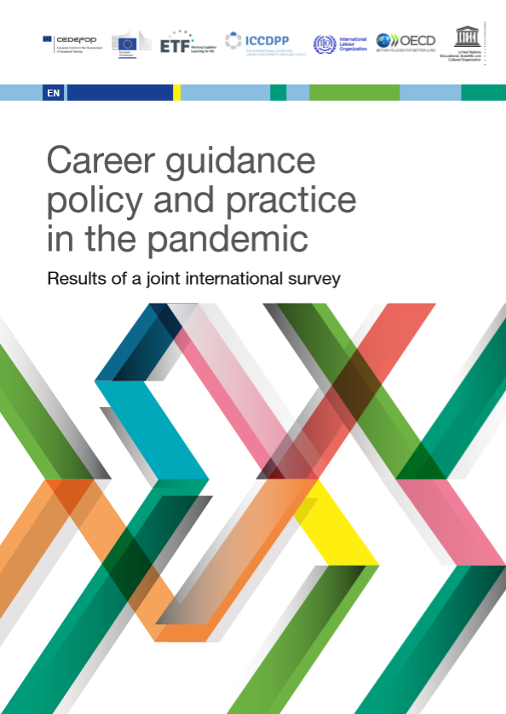
Policy and practice in the pandemic
Many countries have invested in career guidance as part of their response to the pandemic.
The rapid adoption of new technologies has been essential in the delivery of career guidance.
There has been an increased demand for career guidance, in particular, demands for labour market information, job-search assistance, reskilling opportunities, and education and training opportunities.
Career guidance can support the post-pandemic recovery. Respondents confirmed the potential of career guidance to contribute to the recovery in terms of efficient investment in education, skills development, labour market efficiency, and social inclusion.

Slide 15
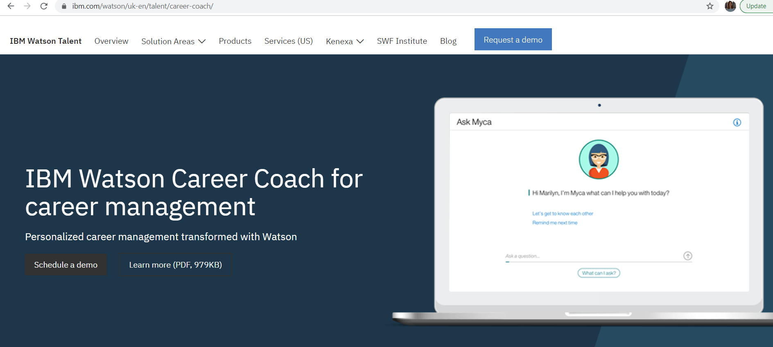
Implications to careers of professionals who provide career development support?
Developing expertise in high-tech (e.g., use of technology to perform self-assessments and gather career information) as well as high-touch (or helping) domains
Digital guidance has to be a core competency
Technological supports may be able to assist with some of the more routine aspects of career planning/change, while human service providers might then have more time to help with particular decisional difficulties or with more complex career problem scenarios

Slide 16
How do you find this data?
What is your perspective on this?
What skills will be vitally important? How to develop them in a targeted manner?

Slide 17
Does the change of career guidance and counselling concept over time also reflect changes in the world the work?
You can read more about this:
Herr, E. L., & Shahnasarian, M. (2001). Selected milestones in the evolution of career development practices in the twentieth century. The Career Development Quarterly, 49(3), 225-232.
You can also investigate this topic even further…

Slide 18
Next steps…
At the beginning of Unit 2 you fill find more information about consequences of the megatrends for enterprises…

Slide 19
References
Cedefop; European Commission; ETF; ICCDPP; ILO; OECD; UNESCO (2020). Career guidance policy and practice in the pandemic: results of a joint international survey – June to August 2020. Luxembourg: Publications Office of the European Union. http://data.europa.eu/doi/10.2801/318103
Bergmo-Prvulovic, I. (2017). Demographic changes and the need for later career opportunities. Dyskursy Młodych Andragogów, 18, 187-206.
Di Fabio, A., & Bucci, O. (2016). Green positive guidance and green positive life counseling for decent work and decent lives: Some empirical results. Frontiers in psychology, 7, 261.
Hirschi, A. (2018). The fourth industrial revolution: Issues and implications for career research and practice. The career development quarterly, 66(3), 192-204.
Lent, R. W. (2018). Future of work in the digital world: Preparing for instability and opportunity. The Career Development Quarterly, 66(3), 205-219.
Plant, P. (2020). Paradigms under Pressure: Green Guidance. Nordic Journal of Transitions, Careers and Guidance, 1(1).

Slide 20
Thank you for the attention. Questions?

