Slide 1
Unit 2 Session 2 Commitment to Corporate Social Responsibility
2.2p: Definition, Conceptual Framework, Motives. Role of HRM
Filiz Keser Aschenberger, Monika Petermandl, Klausjürgen Heinrich
This license lets you (or other party) share, remix, transform, and build upon this material non-commercially, as long as you credit the Connect! project partners and license your new creations under identical terms.

Slide 2
Overview of the Session
The goal:
At the end of this session, you will be able to
-explain corporate social responsibility as a driver in our society
-identify the role of HR professionals for CSR
-describe examples of successful social responsibility activities

Slide 3
Overview of the Session
The Topics
Conceptual framework
Role of context
Motivation for CSR
Impact on HR/Role of HR in CSR
HRM‘s Domains of Contribution to CSR
CSR in SMEs
Global and EU principles & guidelines
Best Practice Examples

Slide 4
Conceptual Framework
History
CSR is not a new issue
social responsibility discourses ‘become not only acceptable in leading business circles, but even fashionable’ in 1953 (Gond et al., 2011, p. 44)
Over the past two decades interest in CSR has been steadily increasing. This is a result of three related developments:
First, political changes have led to a relative erosion of the power of national governments
Second, civil society in industrialised countries has undergone important changes in recent decades regarding awareness of environmental problems and persisting social inequality,
Third, we see an increasing mobility of corporations and a growing importance of financial markets for economic success.
Magnified by media pressure and advances in information technology, these three developments have raised expectations that business – given its growing economic role in society – should play a more prominent social role too. (Preuss et al, 2009, p. 955)

Slide 5
Conceptual Framework
Is it best understood as
ideology, policy, practice, or process?
corporate largesse, soft regulation, public relations, corporate accountability, corporate hegemony?
It is amorphous, contested, and dynamic phenomenon
Its definition varies with time, region, country and culture as well with types of organizations.
It overlaps with other concepts that describe the business–society relationship, such as business ethics, corporate sustainability, or corporate citizenship.
To differentiate between different approaches to CSR one needs to consider foundational questions:
What is the purpose of the firm?
To whom is the firm responsible?
What is the role of the firm with respect to society?
What is the position of stakeholders?
And what is the role of government/regulation? (Voegtlin & Greenwood, 2015)

Slide 6
Conceptual Framework
Definitions
Corporate Social Responsibility (CSR) is an umbrella term to describe how business firms, small and large, integrate social, environmental and ethical responsibilities to which they are connected into their core business strategies, structures and procedures within and across divisions, functions as well as value chains in collaboration with relevant stakeholders (Wickert & Risi, 2019, p. 1).
It is not anymore about how the money is spent but how the money is made (Wickert & Risi, 2019, p. 1).

Slide 7
Conceptual Framework
Definition from EU Green Paper
CSR is a concept whereby companies integrate social and environmental concerns in their business operations and in their interaction with their stakeholders on a voluntary basis (Green Paper, Commission of the European Communities, 2001, p. 6).
CSR provides the foundations of an integrated approach that combines economic, environmental and social interests to their mutual benefit.
It opens a way of managing change and of reconciling social development with improved competitiveness.
Being socially responsible means not just fully meeting legal expectations, but also going beyond compliance by investing “more” into human capital, the environment and their relations with stakeholders.

Slide 8
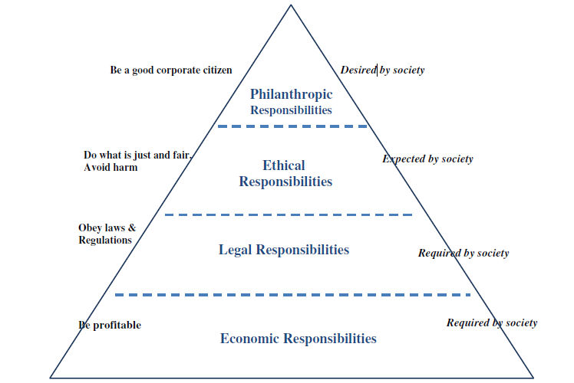
Conceptual Framework
The pyramid of CSR (Carroll, 1979)
“Corporate social responsibility encompasses the economic, legal, ethical, and discretionary (philanthropic) expectations that society has of organizations at a given point in time” (Carroll, 2016, p. 2).

Slide 9
Conceptual Framework
CSR
Business ethics
Ethical stakeholder behavior
Good corporate governance
Corporate social performance
Corporate sustainability
Corporate citizenship
Stakeholder approach
Corporate accountability
Related Concepts
connect-erasmus.eu

Slide 10
Role of Context
Context matters: CSR and Institutional Context of the Corporation
Matten & Moon (2008) developed a framework based on the interaction of following elements:
National Context
Political system
Financial system
Education and Labour system
Cultural system
The corporation
Nature of the firm
Organization of market processes
Control and coordination systems

Slide 11
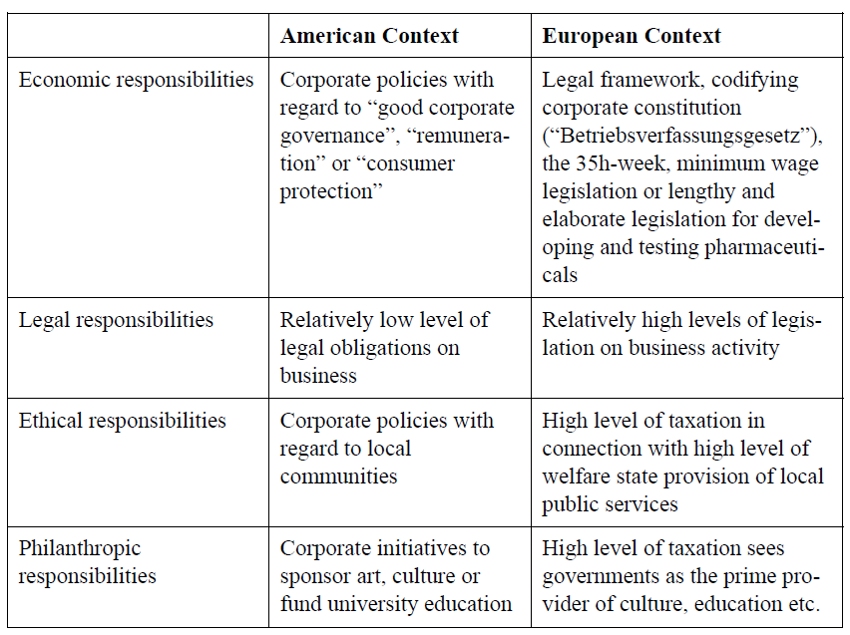
Role of Context
Context matters:
CSR issues in the American and European contexts (examples) (Matten & Moon, 2008)

Slide 12
Motives for CSR
Two main motives
Ethical motives (intrinsic)
Promoting social innovation, cohesion, inclusion and sustainability
Instrumental (extrinsic) motives
to attract talent, increase employee engagement, motivation and satisfaction, and reduce employee retention, all of which would ultimately contribute to job performance and productivity.
to enhance trust and support of consumers and investors in products and brands. This allows for creating a favourable reputation, increased sales, and the ability to charge a price premium for socially responsible and sustainable products.
to reduce costs. For instance, the implementation of eco-efficiency or recycling measures leads to energy savings and reductions in waste and raw materials used.
to achieve more effective management of environmental and social risks.
to contribute to a company’s competitiveness (Wickert & Risi, 2019, pp. 25-31).

Slide 13
Impact of Social Responsibility
An organization’s performance on social responsibility can influence, among other things:
Competitive advantage
Reputation
The ability to attract and retain workers or members, customers, clients and users
The maintenance of employee morale, commitment and productivity
The perception of investors, owners, donors, sponsors and the financial community
Relationships with companies, governments, the media, suppliers, peers, customers and the community in which it operates (ISO 26000)
There is not strong evidence on the relationship between increased profit and CSR.

Slide 14
CSR & HRM Relationship
Trends in CSR–HRM research with regard to the CSR and HRM relationship. Voegtlin & Greenwood (2016)
CSR and HRM relationship | Specifications
HRM as a component of CSR HRM as an element of CSR. CSR as the focus of the research | HRM as antecedent to CSR “Human resources” (i.e. workers) and human resource management as enabling of CSR in the organization HRM as subset of CSR HRM is one of several factors that make up CSR.
CSR as a component of HRM CSR as an element of HRM. HRM as the focus of the research | CSR as enabling “effective” HRM CSR is used to achieve HRM goals (e.g. improving recruitment or mitigating regulation). CSR as enabling “responsible” HRM CSR is considered a means for ensuring responsible management of workers.
CSR and HRM as mutually dependent Both CSR and HRM are the focus of the research | CSR and HRM present but no overlap CSR and HRM both identified as subjects but discussed in parallel (e.g. both are variables of another construct). CSR and HRM in interaction CSR–HRM as a complex and rich interactive phenomena. Workers, worker representatives, and those who manage workers, are actors in networks involving multiple stakeholders and institutions.

Slide 15
Implications for HRM
The rise of CSR has significant implications for HRM practice. Ranging from ethical standards in dealing with important stakeholders through employment practices that attract employees to social involvement in the form of employee volunteering, the HRM role is awash with CSR-related tasks. (Preuss et al., 2009)
HR is the key to CSR‘s successful deployment and implementation
HRM can provide a promising managerial framework that can support organizational efforts in translating CSR strategies into practical managerial actions and out comes, especially within the internal organizational environment
At company level, socially responsible practices involve primarily employees and relate to issues such as investing in human capital, health and safety, and managing change (Green Paper).

Slide 16
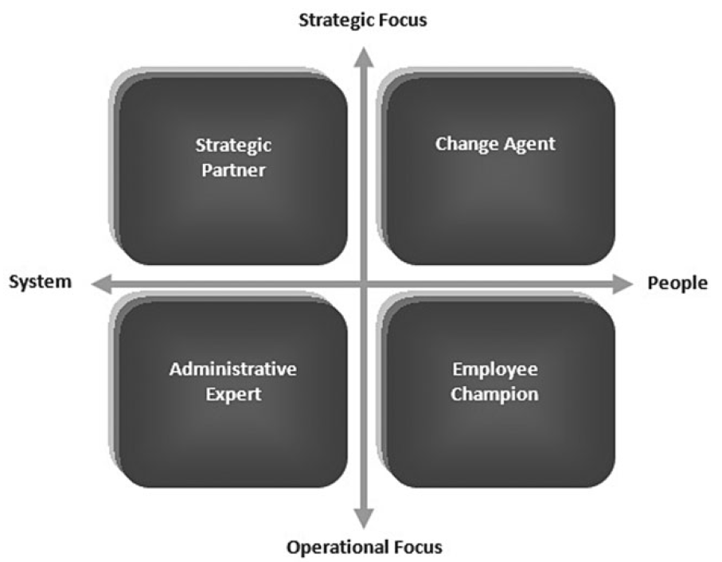
Role of HR in CSR
Strategic human resource management (HRM) partnership model (Jamali et al. 2015, p. 130)

Slide 17
Domains of Contributions
HRM’s domains of contribution into CSR | Role
Helps define and execute CSR | Strategic partner
Helps create CSR change | Change agent
Helps increase employee contribution to CSR | Employee champion
Helps deliver CSR efficiently | Administrative expert
Source: Jamali et al., 2015, p. 135

Slide 18
Domains of Contributions
As Strategic Partner:
Helps define and execute CSR
• Contributing to the development of CSR
• Suggest CSR scopes from HRM point of view
• Integrating CSR into HRM’s mission and functions
• Developing plans to gather information about CSR orientations from stakeholder perspectives with specific focus on employees
Source: Jamali et al., 2015, p. 135

Slide 19
Domains of Contributions
As Change Agent
Helps create CSR change
• Understanding how CSR change will affect other stakeholders (customers, investors, community)
• Increasing employees’ sensitivity and readiness to interact with the change to incorporate CSR
• Introducing initiatives that promote CSR objectives and overcome resistance to change and other barriers
• Raising managers’ awareness to CSR change through training and development
Source: Jamali et al., 2015, p. 135

Slide 20
Domains of Contributions
As Employee Champion
Helps increase employee contribution to CSR
• Increasing employee engagement and motivation for CSR
• Sharing and communicating the value of CSR to employees from early recruitment stages to performance management to compensation and rewarding to retention plans
• Enhancing employee education and awareness about CSR
• Providing initiatives that help employees serve the community, such as social volunteering programs
• Gathering/sharing information with employees in relation to CSR
• Celebrating successful CSR activities with employees
• Drafting and implementing employee codes of conduct
Source: Jamali et al., 2015, p. 135

Slide 21
Domains of Contributions
As Administrative Expert
Helps deliver CSR efficiently
• Setting CSR performance indicators and monitoring results to performance objectives within the HRM performance management systems
• Dealing with social and legal issues associated with CSR practices once applicable from an HRM perspectives and depending on HRM’s expertise and capabilities
• Measuring and reporting CSR performance and bottom line pay off through HRM devices and assessment tools
• Measuring and reporting human capital metrics such as turnover, health and safety, employee development, and diversity as part of wider social performance measurement across the whole organization
Source: Jamali et al., 2015, p. 135

Slide 22
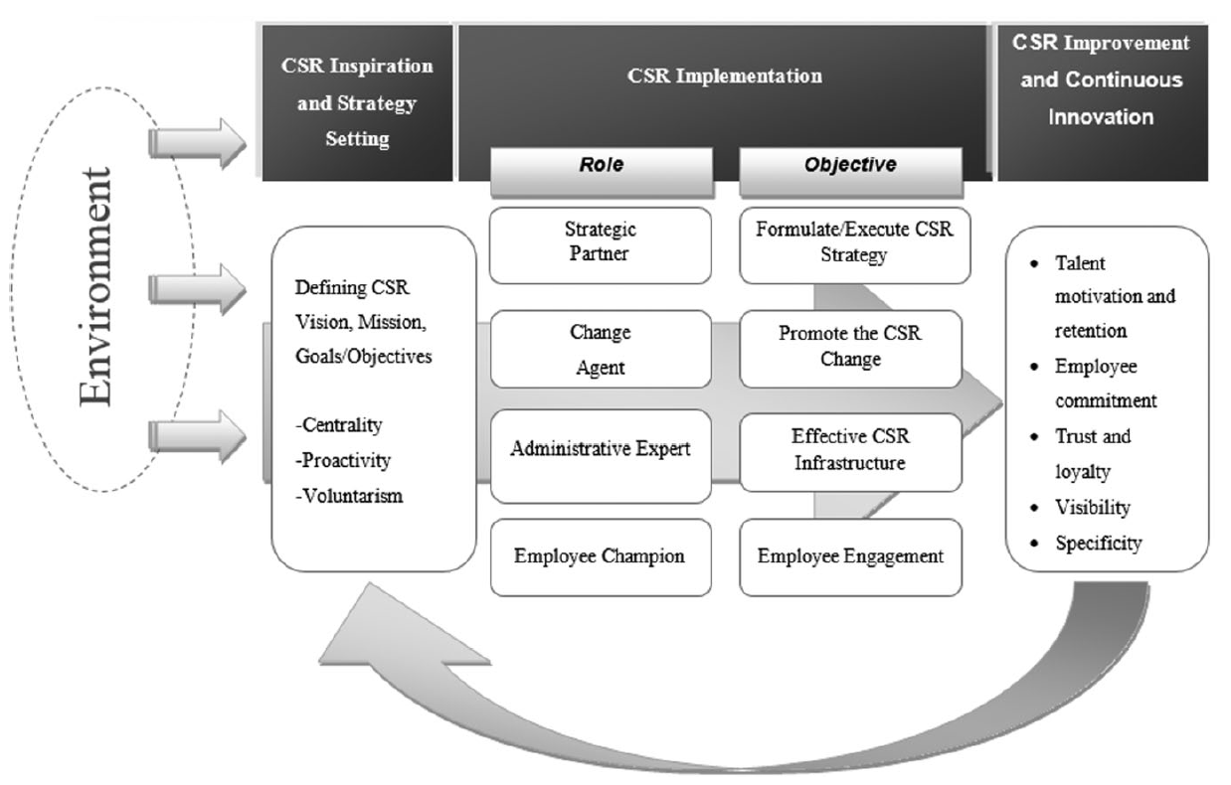
Domains of Contributions
The CSR-HRM Co-creation Model
The model maps the HRM roles over three important milestones of a typical strategic CSR lifecycle namely,
(1) the inception and strategy setting phase;
(2) enacting CSR implementation;
(3) engaging in learning and improvement through continuous assessment of outcomes
Jamali et al., 2015, p. 133

Slide 23
CSR Embedded in HRM Practices
HRM Practices
Recruitment and selection
Hiring new recruits capable of contributing to CSR
Screening new recruits with knowledge and awareness and appreciation for CSR
Hiring new recruits capable of contributing to CSR and, for example, with previous experience in volunteering activities
Include questions and case studies about CSR within the interview stages with candidates
Include sections on CSR activities in employee handbook and orientation programs (Jamali et al., 2015)

Slide 24
CSR Embedded in HRM Practices
HRM Practices
Performance appraisal
Defining performance based not only on outcomes and results but also on social objectives
Include service to community and participation and involvement and contribution to social initiatives as part of the performance appraisal and link it to rewards such as bonuses
Follow up with employees on CSR and include CSR action plans and motivate employees to engage more in CSR during regular performance evaluation meetings
Allow employees to contribute to formulating CSR performance indicators and involve them in CSR projects (Jamali et al., 2015)

Slide 25
CSR Embedded in HRM Practices
HRM Practices
Reward and compensation
Employees for behaviours consistent with CSR values to motivate them and emphasize the importance of CSR to the organization
Preparing tangible and intangible rewards for employees’ participation in CSR
Preparing incentives that promote social goals
Communicating such schemes with external stakeholders to enhance the company’s reputation and market attractiveness (Jamali et al., 2015)

Slide 26
CSR Embedded in HRM Practices
HRM Practices
Training and development
Training and raising employees’ awareness to CSR, for example, sustainability practices such as green practices and recycling inside as well as outside the organization
Holding regular seminars and workshops on CSR and linking some incentives and rewards to employees’ participation in them
Training programs and skills development could be for both lower and higher employee levels
Invite NGO representatives to share experience with employees in relation to common CSR projects (Jamali et al., 2015)

Slide 27
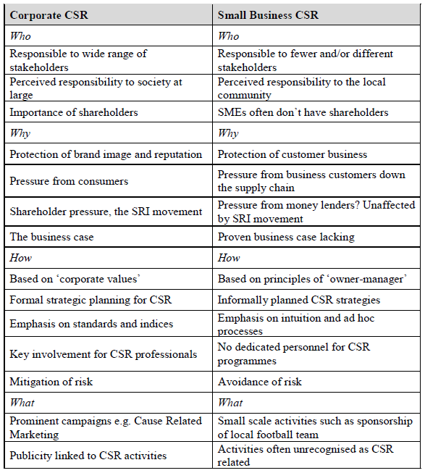
CSR in SMEs
CSR may differ in SEMs
In the crucial who, why, how and what of CSR, SMEs response may differ due to cultural differences created by diverse ownership structures, strategic direction, owner-manager characteristics and geographic location.
Large companies are usually very aware of their CSR, while small companies may be carrying out CSR without recognizing it as such.
There are many opportunities for SME managers to embrace the CSR agenda as they are more flexible, more responsive and better at internal communication. (Jenkins, 2004, p. 51)

Slide 28
Global and EU Principles & Guidelines
Some common guidelines
EU Green Paper
UN Global Compact Principles
ISO 26000- Guidance on Social Responsibility
OECD- Guidelines for Responsible Business

Slide 29
Global and EU Principles & Guidelines
Green Paper (2001): Promoting a European framework for Corporate Social Responsibility
Key Issues:
Corporate social responsibility: the internal dimension
1. Human resources management
2. Health and safety at work
3. Adaptation to change
Corporate social responsibility: the external dimension
1. Local communities
2. Business partners, suppliers and consumers
3. Human rights
4. Environmental Responsibility
5. Sustainable development
Social responsibility integrated management
Socially responsible investment

Slide 30
Global and EU Principles & Guidelines
Human Resources Management in Green Paper
33. A major challenge for enterprises today is to attract and retain skilled workers. In this context, measures developed by companies to motivate employees include
life long learning,
empowerment of employees,
better information throughout the company,
better balance between work, family, and leisure,
greater work force diversity, equal pay and career prospects for women,
profit sharing and share ownership schemes, and
concern for employability as well as job security.
34. Responsible recruitment practices, involving in particular non-discriminatory practices, should facilitate the recruitment of people from ethnic minorities, older workers, women and the long term unemployed and people at disadvantage. Such practices are essential in relation to achieving the European Employment Strategy objectives of reducing unemployment, raising the employment rate, and fighting against social exclusion.

Slide 31
Global and EU Principles & Guidelines
Human Resources Management in Green Paper
35. In relation to life-long learning, businesses have a key role to play at several levels:
contributing to a better definition of training needs through close partnership with local actors who design education and training programmes;
supporting the transition from school to work for young people, for example by providing apprenticeship places;
valuing learning, in particular in the Accreditation of Prior and Experiential Learning (APEL); and
providing an environment which encourages lifelong learning by all employees, particularly by the less educated, the less skilled and older workers.
36. Those practices which improve quality in work can have a direct impact on profits through
increased productivity,
lower staff turnover,
less resistance to change and greater innovation,
higher quality and reliability of products and services.

Slide 32
Global and EU Principles & Guidelines
UN Global Compact Principles
Human Rights
Principle 1: Businesses should support and respect the protection of internationally proclaimed human rights; and
Principle 2: make sure that they are not complicit in human rights abuses.
Labour
Principle 3: Businesses should uphold the freedom of association and the effective recognition of the right to collective bargaining;
Principle 4: the elimination of all forms of forced and compulsory labour;
Principle 5: the effective abolition of child labour; and
Principle 6: the elimination of discrimination in respect of employment and occupation.
Environment
Principle 7: Businesses should support a precautionary approach to environmental challenges;
Principle 8: undertake initiatives to promote greater environmental responsibility; and
Principle 9: encourage the development and diffusion of environmentally friendly technologies.
Anti-Corruption
Principle 10: Businesses should work against corruption in all its forms, including extortion and bribery.

Slide 33
Global and EU Principles & Guidelines
ISO 26000-Guidance on Social Responsibility
It is a stepping stone for organizations in both the public and private sectors who want to implement ISO 26000 as a means of achieving the benefits of operating in a socially responsible manner.
ISO 26000 provides guidance for all types of organization, regardless of their size or location, on :
1. Concepts, terms and definitions related to social responsibility
2. Background, trends and characteristics of social responsibility
3. Principles and practices relating to social responsibility
4. Core subjects and issues of social responsibility
5. Integrating, implementing and promoting socially responsible behaviour throughout the organization and, through its policies and practices, within its sphere of influence
6. Identifying and engaging with stakeholders
7. Communicating commitments, performance and other information related to social responsibility
ISO 26000 is not a management system standard. It does not contain requirements and, as such, cannot be used for certification. Any offer to certify, or claims to be certified, against ISO 26000 would be a misrepresentation of its intent and purpose.

Slide 34
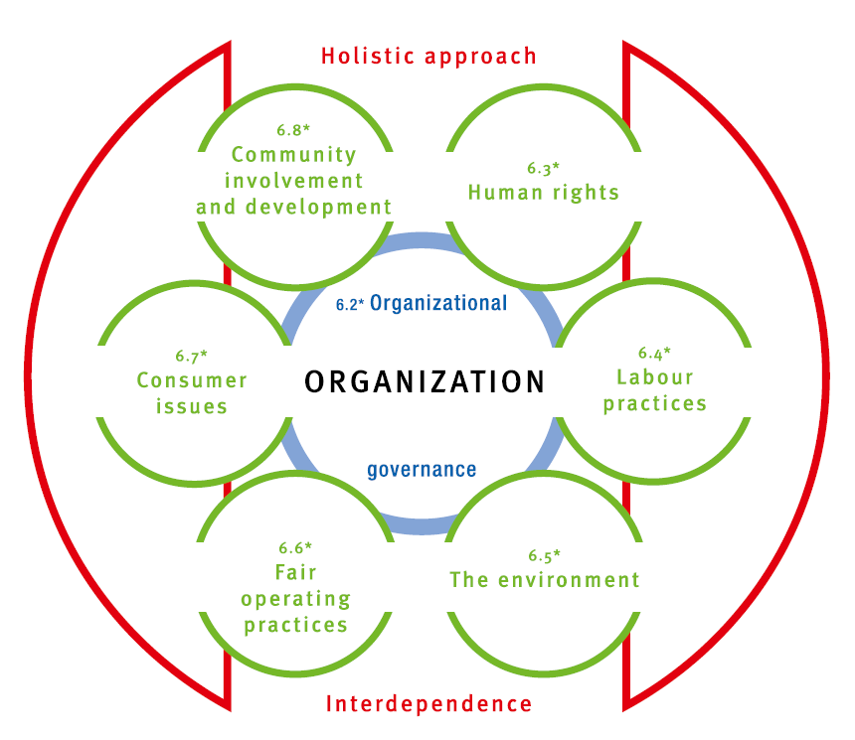
Global and EU Principles & Guidelines
ISO-26000 Core Concepts

Slide 35
Global and EU Principles & Guidelines
OECD (2011) Guidelines for Responsible Business
Principles
Human Rights
Employment and Industrial Relations
Environment
Combating Bribery, Bribe Solicitation and Extortion
Consumer Interests
Science and Technology
Competition
Taxation

Slide 36
Best Practice Examples
Forbes List for world’s most reputable companies for corporate responsibility (2019)
https://www.forbes.com/sites/vickyvalet/2019/09/17/the-worlds-most-reputable-companies-for-corporate-responsibility-2019/?sh=5f7eaa07679b
1 | LEGO Group
2 | Natura
3 | Microsoft
4 | Google
5 | The Walt Disney Company
6 | The Bosch Group
7 | Havaianas
8 | Intel
9 | Lavazza
10 | IKEA

Slide 37
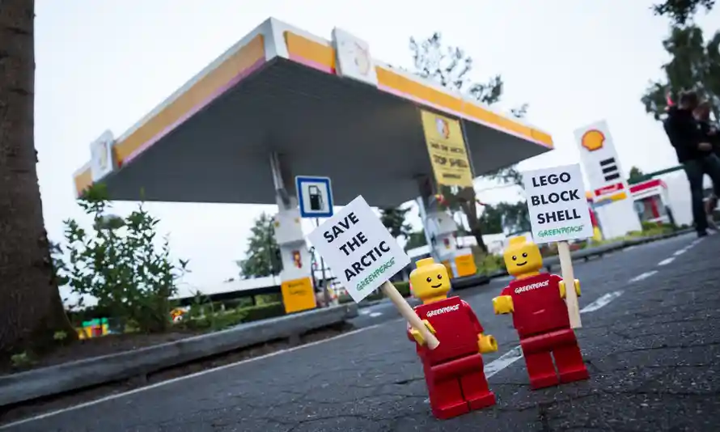
Best Practice Examples
LEGO
Greenpeace Case: How did LEGO react to campaign organized by Greenpeace?
https://youtu.be/qhbliUq0_r4
https://www.theguardian.com/environment/2014/oct/09/lego-ends-shell-partnership-following-greenpeace-campaign
How LEGO rebuilt itself as a purposeful and sustainable brand?
https://www.forbes.com/sites/simonmainwaring/2016/08/11/how-lego-rebuilt-itself-as-a-purposeful-and-sustainable-brand/?sh=641e125c6f3c

Slide 38
Further Sources on CSR
https://www.goodreturns.org/blog/5-creative-csr-initiatives
What is CSR: https://youtu.be/1bpf_sHebLI
TedTalk The social responsibility of business | Alex Edmans | TEDxLondonBusinessSchool https://www.youtube.com/watch?v=Z5KZhm19EO0
Corporate Social Responsibility (CSR): Practical Perspectives by Thomas Beschorner https://youtu.be/l9IyDvkxADU
Business and Corporate Social Responsibility (CSR) https://youtu.be/nkteAJBtM9A

Slide 39
Thank you for your attention. We are looking forward to your comments and your questions.

