Slide 1

Systems Theory Framework of
Career Development (STF)
Unit 3
Session 1
Lea Ferrari​
Teresa Maria Sgaramella
This license lets you (or other party) share, remix, transform, and build upon this material non-commercially, as long as you credit the Connect! project partners and license your new creations under identical terms.

Slide 2
The aim of the presentation
Foundations of System theory Framework
Foundations for a System theory Framework of Career Development

Slide 3
Systems Theory
  Organisms are viewed as a whole of interacting parts rather than as parts in isolation from other parts
  “Single parts and processes cannot provide a complete picture of the vital phenomena” (Von Bertalanffy, 1934, p. 64)
  A system is a “complex of elements standing in interaction” (Von Bertalanffy, 1968, p. 33)
  “The systems approach is in a position to take the most useful concepts of each theory of career development and apply them to the understanding of career behavior” (Osipow, 1983, p. 320)
McMahon & Patton 2016
SVP Conference

Slide 4
Systems Theory Framework (STF)
  Is a metatheoretical framework (McMahon & Patton, 1995)
  Recognises the contribution of all theories
  Systemic thinking assumes an “individual in context” perspective (McMahon, Watson, & Patton, 2014, p. 30)

Slide 5
Systems and Influences in a STF
values
gender
health
sexual orientation
ability
disability
interests
INDIVIDUAL
beliefs
skills
world-of-work knowledge
personality
age
physical attributes
self-concept
aptitudes
ethnicity
Patton & McMahon (1999)

Slide 6
Systems and Influences in a STF
Peers
values
Education institutions
gender
health
sexual orientation
Family
disability
ability
interests
INDIVIDUAL
beliefs
skills
world-of-work knowledge
personality
age
Physical attributes
self-concept
Media
Workplace
aptitudes
ethnicity
Community groups
Patton & McMahon (1999)

Slide 7
Systems and Influences in a STF
Geographical location
Peers
Political decisions
values
gender
Education institutions
sexual orientation
Family
health
ability
disability
interests
INDIVIDUAL
beliefs
skills
Historical
trends
Employment market
world-of-work knowledge
personality
age
physical attributes
self-concept
Media
Workplace
aptitudes
ethnicity
Socioeconomic status
Community groups
Globalization
Patton & McMahon (1999)

Slide 8
Systems and Influences in a STF
Geographical location
Peers
Political decisions
values
Education institutions
gender
health
sexual orientation
Family
ability
disability
interests
INDIVIDUAL
beliefs
skills
Historical trends
Employment
market
world-of-work knowledge
personality
age
physical attributes
self-concept
Workplace
Media
aptitudes
ethnicity
Socioeconomic status
Community groups
Globalization
Copyright Patton & McMahon (1999)

Slide 9
Systems and Influences in a STF
Present
Geographical location
Peers
Political decisions
values
gender
Education
institutions
health
sexual orientation
ability
INDIVIDUAL
Family
disability
interests
beliefs
skills
world-of-work
knowledge
Historical trends
Employment
market
personality
age
physical attributes
Workplace
self-concept
Media
aptitudes
ethnicity
Socioeconomic status
Community groups
Globalization
Patton & McMahon (1999)

Slide 10
Systems Theory Framework of Career Development (STF)
Connecting Theory and Practice
  the STF is readily applied in practice (career assessment and career counselling)
  “conceptual and practical map for career counsellors”
(McMahon & Patton, 2006, p. 94)
(C) McMahon & Patton 2016
SVP Conference

Slide 11
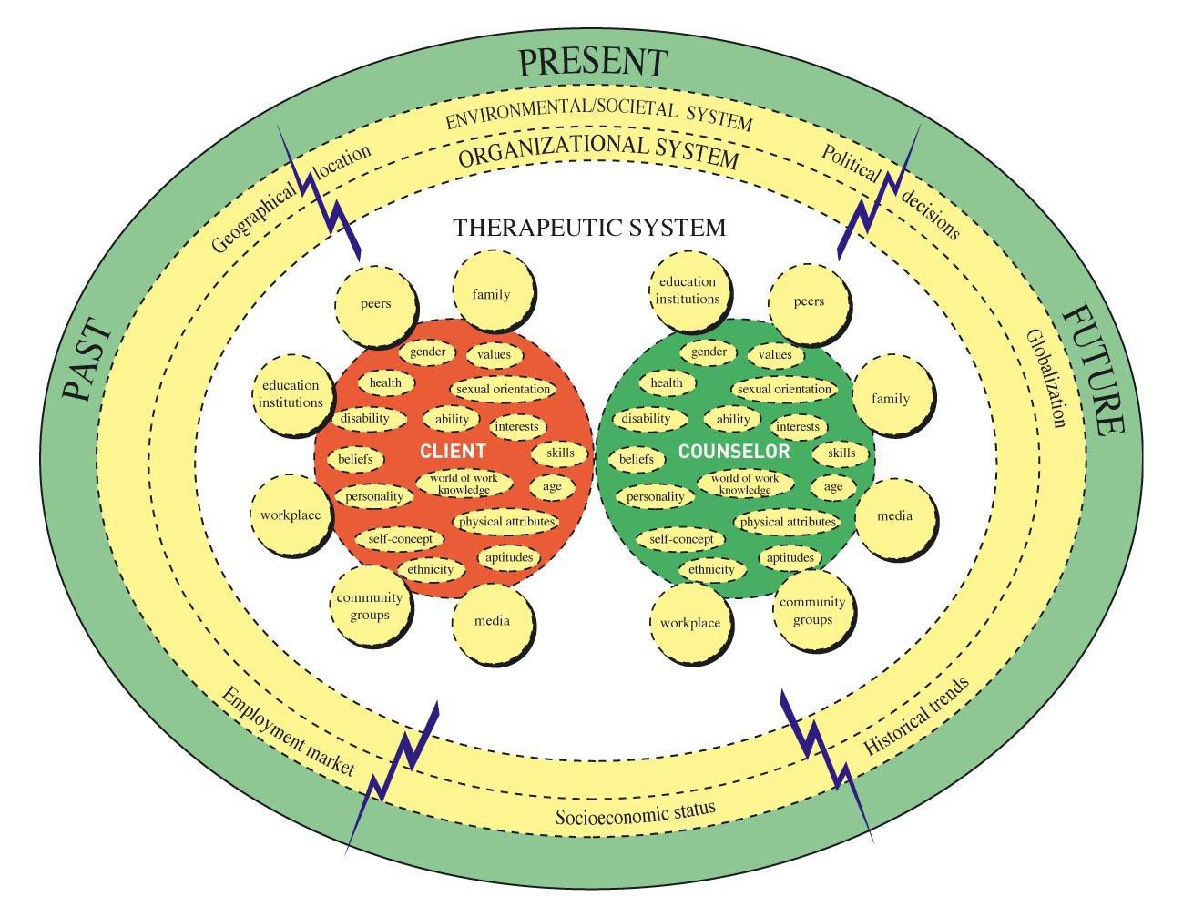
Systems Theory Framework of Career Development: mapping the influences
McMahon & Patton 2016

Slide 12
Systems Theory Framework of Career Development
Application to Career Assessment
Starting point Entering the life space of the client
Outcomes
Story continues
Career action
Story and
Meaning
Career assessment processes
(from McMahon & Patton, 2006, p. 170)

Slide 13
Systems Theory Framework of Career Development (STF)
STF Application to Career Counselling
  “working with storytellers” (McMahon, 2006, p. 16)
  Story telling approach to career counselling (McMahon, 2007, 2009; McMahon & Watson, 2010, 2012, 2013)
  Practice constructs (McMahon, 2005)
    Reflection
    Connectedness
    Meaning Making
    Learning
    Agency

Slide 14
Systems Theory Framework of Career Development (STF)
The Story Telling Approach encourages individuals to
  engage in a reflective process (reflection) …
  tell their stories in relation to the systems of influence within which they live (connectedness),
  begin to understand how identified influences have impacted on their story (meaning making),
  identify themes and patterns evident within and across stories (learning), …
  play a more active role in constructing their future identities and career stories (agency)
  (McMahon, Patton, & Watson, 2015, p. 151)

Slide 15
Systems Theory Framework of Career Development (STF)
Advantages of STF Application to Career Counselling and Career Assessment
  Practical and user friendly
  Flexible way to treat each client uniquely
  Accommodates a range of approaches to theory and assessment
  Context resonant
    systemic thinking
    accommodates cultural diversity
    applies to a range of cultural groups and settings (see Patton, McMahon, & Watson, 2006, McMahon, Watson, Chetty, & Hoelson, 2012)
    utility in career counseling and qualitative career assessment in a range of international settings (e.g., Australia, Canada, Japna, Hong Kong, Italy, South Africa, Switzerland)
    defines culture inclusively
    incorporates personal culture of career counsellors
    examines multiple systems of influence
    interventions are possible at multiple levels
    McMahon & Patton 2016 SVP Conference

Slide 16
Thank you for the Attention.

