Slide 1
Career Construction Interview
Unit 3​​
Session 2​
Lea Ferrari​
Teresa Maria Sgaramella
This license lets you (or other party) share, remix, transform, and build upon this material non-commercially, as long as you credit the Connect! project partners and license your new creations under identical terms.

Slide 2
Aim of the presentation
Illustrate the Career Construction Interview
Analyse one interview
Explore some cases

Slide 3
Introduction
Created by Mark L. Savickas , the Career Construction Interview (CCI) is a structured interview that permits counselors to gather information (micro-narrative stories) to co-construct with clients the Life Portrait (macro narrative story).
The CCI questions helps clients to elicit how they have constructed their self, their identity, and their career and who they wish to become.

Slide 4
What are the CCI Topics?
1. Role Models
Clients describe 3 role models of their childhood/adolescence to reveal to counselors their self-concept.
2. Magazines, Webistes, TV Shows
They reveal the types of environments and activities that interest the clients.
More personal
3. Favorite story
Clients tell a story where the major character faces their same problem. The story shows how the character dealt with the problem.
4. Favorite saying
It articulates the best advice that clients have for themselves.
5. Early recollections
They provide the most precise and clear indication of the clients’ central life problem and preoccupation.

Slide 5
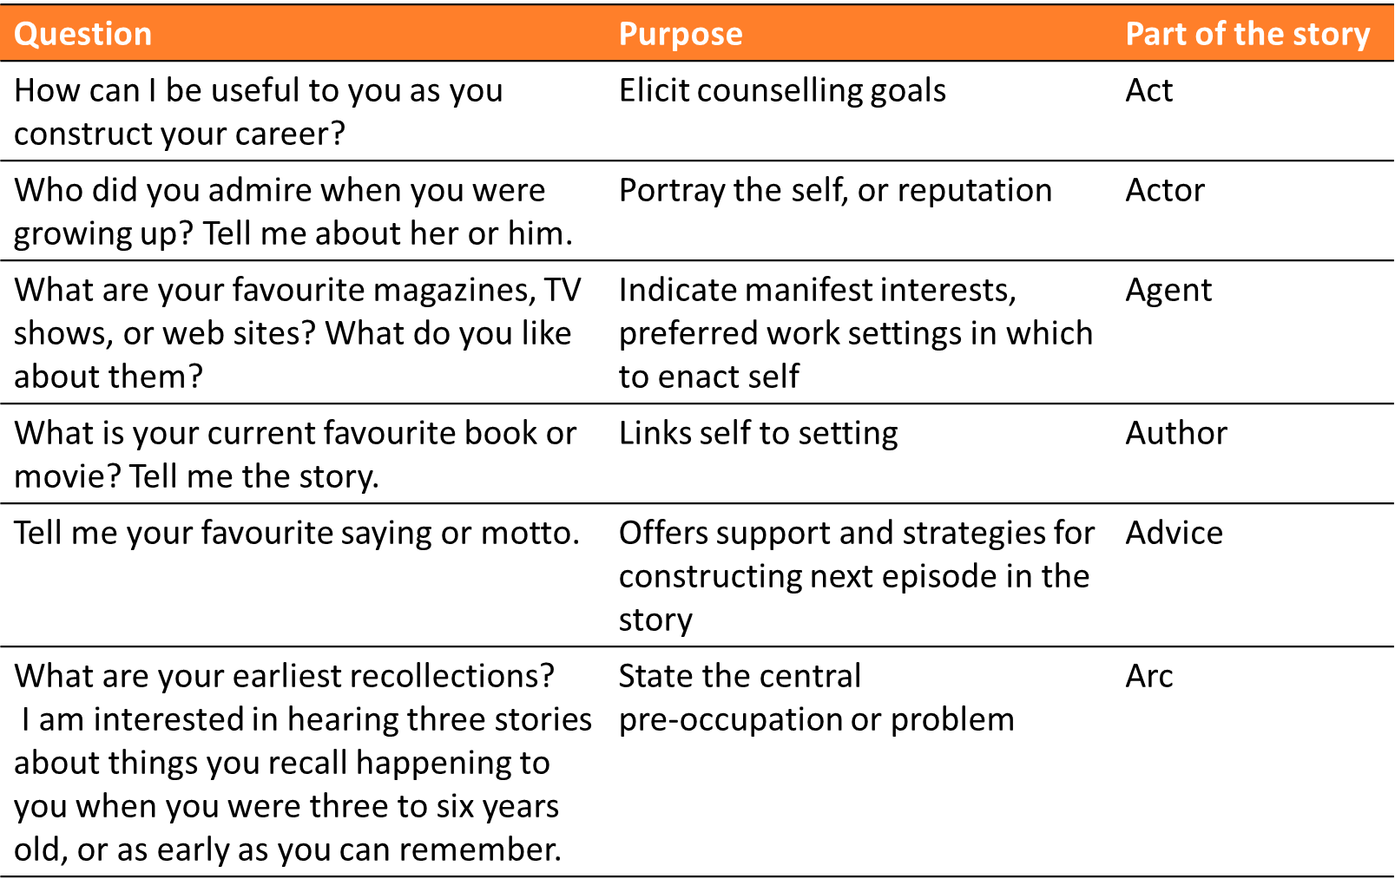
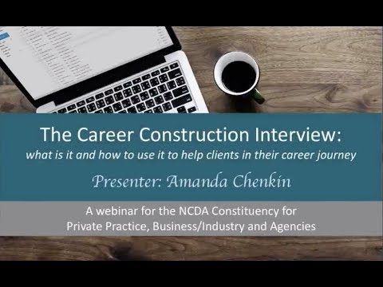
the what and why of the CCI
From Hartung, P. J. (2015). The career construction interview. In Career Assessment (pp. 115-121). Brill Sense.

Slide 6
CCI Example
Client’s description (1/2)
Elaine, a 20-year-old full-time college student who has just completed the fall semester of her sophomore year. During the spring semester, she must declare her major.
She has considered different options, but she can not decide:
-premed and then enter medical school (like her mum wishes)
-civil engineering (easier) or chemical engineering (good choice)

Slide 7
CCI Example
Elaine’s actions before the career construction counselling
She talked about careers with her college counselor yet then felt even more undecided;
She requested information from another college where they have better integrated computers into their chemical engineering curriculum.
She was attracted by computers and liked the idea that if she transferred to that college she could live in a dormitory.

Slide 8
CCI Example
Elicit counselling goals
She wants to know why she can not choose an academic major
She needs helps in making a choice
She wonders whether medicine would be the right choice for her

Slide 9
CCI Example
CCI answers (1/2)
CCI topic | Answer
Role models | 1. Anne of Green Gables: she had spirit and a temper, set goals and went after them, did what she wanted, had integrity, and had fun. 2.The heroine in the book A Wrinkle in Time: she led her friends in a showdown against creatures trying to take over their minds. She thought of ways to stick together and fight the creatures. 3.Laura, in the book Little House on the Prairie: she had wild ideas of things to do and enjoyed competing with and outdoing others.
Magazines, Books, TV Shows, Websites | Vogue because: it is about fashion. BusinessWeek: it is about advertising campaigns. Details: it is about men’s clothing. Laverne and Shirley: they do things off the norm without getting into trouble.

Slide 10
CCI Example
CCI answers (2/2)
CCI topic | Answer
Favorite story | The Search of Mary Kay Malloy: the story of an Irish girl’s voyage to America by herself.
Favorite saying | “I am curious about things” (from Curious George) “Do it well” (which to her means nearly perfectly)
Early recollection | Little girl annoyed because she must sit still: going to Disneyland with my grandparents and uncle and his girlfriend. I was in the back of the camper trying to sing and dance for my grandmother. She told me to sit down so I would not get hurt. I got on uncle’s girlfriend’s nerves by trying to talk to her. I tried to talk but she did not think I should move around at the same time.

Slide 11
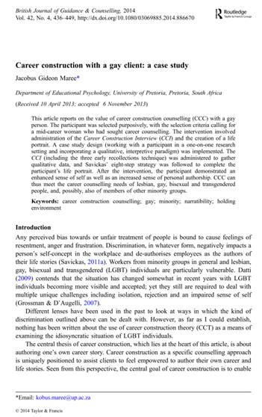
Case Study (1/3)
Maree, J. G. (2014). Career construction with a gay client: A case study. British Journal of Guidance & Counselling, 42(4), 436-449.

Slide 12
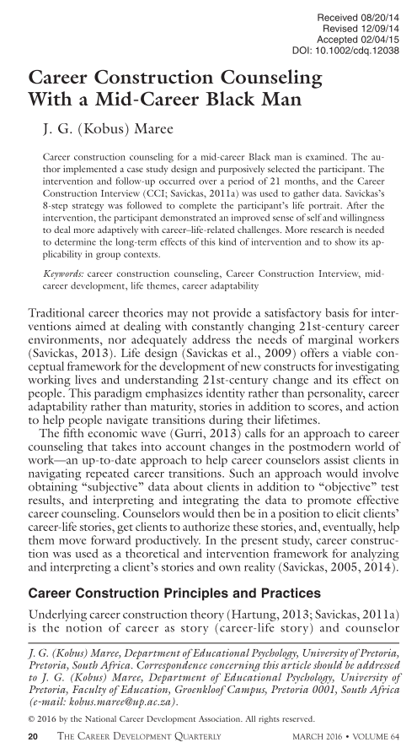
Case Study (2/3)
Maree, J. G. (2016). Career construction counseling with a mid‐career black man. The Career Development Quarterly, 64(1), 20-34.

Slide 13
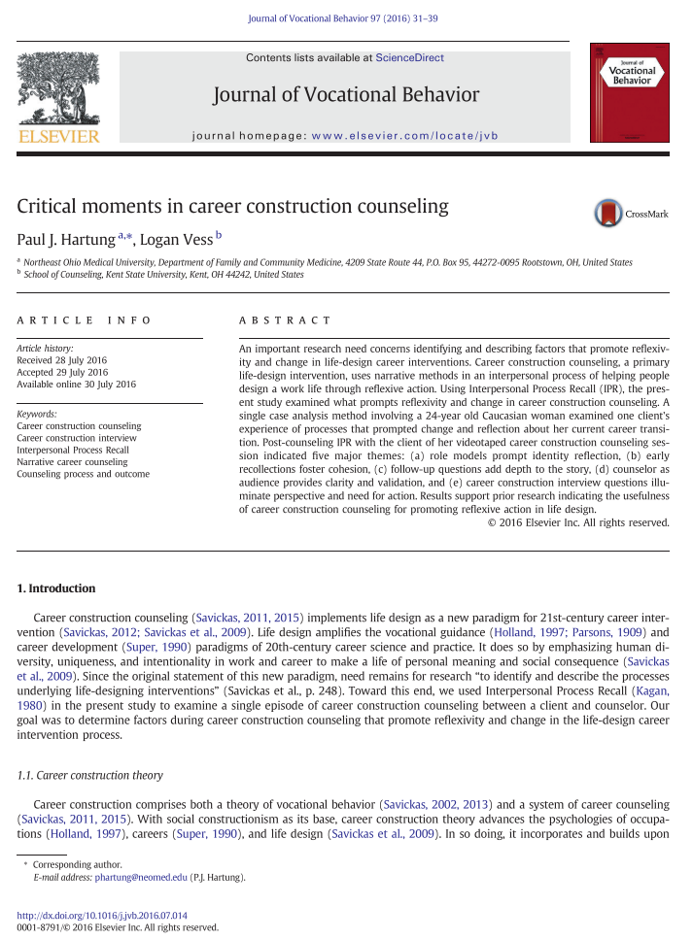
Case Study (3/3)
Hartung, P. J., & Vess, L. (2016). Critical moments in career construction counseling. Journal of Vocational Behavior, 97, 31-39.

Slide 14
Some references
Savickas, M. L. (2011). Career counseling. Washington, DC: American Psychological Association Books.
Savickas, M. L. (2013). Career construction theory and practice. In S. D. Brown & R. W. Lent (Eds.), Career development and counseling: Putting theory and research to work (2nd ed., pp. 147–183). Hoboken, NJ: John Wiley.
Hartung, P. J. (2015). The career construction interview. In Career Assessment (pp. 115-121). Brill Sense.
Savickas, M. (2015). Life-design counseling manual. Mark L. Savickas.

Slide 15
summary questions
what is the CCI?
what are the main topics of the CCI?
what are the purpose of the CCI questions?
what are the part of the story addressed by the CCI?

Slide 16
Questions?

