Slide 1
UD3 - SESSION 3
Implementing career counseling into SMEs
Lea Ferrari​
Teresa Maria Sgaramella

Slide 2
Reconnecting with 3.2
Homework: one tool in practice
Select one of the tools, complete it or ask one person to answer.
Analyse the data and provide a short report.
Provide your considerations about the process.

Slide 3
Reconnecting with 3.2
Knowledge evaluation form 3.2.1
Expected answers
Q1= a
Q2= b
Q3= a
Q4= c
Q5= b
Q6= b
Q7= b
Q8= c
Q9= c
Q10= a

Slide 4

Overview of Session 3
Reconnecting with 3.2. and description of the goal of the session
Teaching Activity 1 - Analysis of results from CCG and HR in IO2 to describe challenging CGC situations
Learning Activity 1: Use acquired knowledge about theoretical paradigms and tools to address challenging CGC situations
Learning Activity 2: Highlight advantages and reflect on how to include CCG into SME as company strategy and develop a plan
Closing thoughts: Summarize potential use of the approaches and tools in SMEs
Homework
Evaluation level of learning

Slide 5
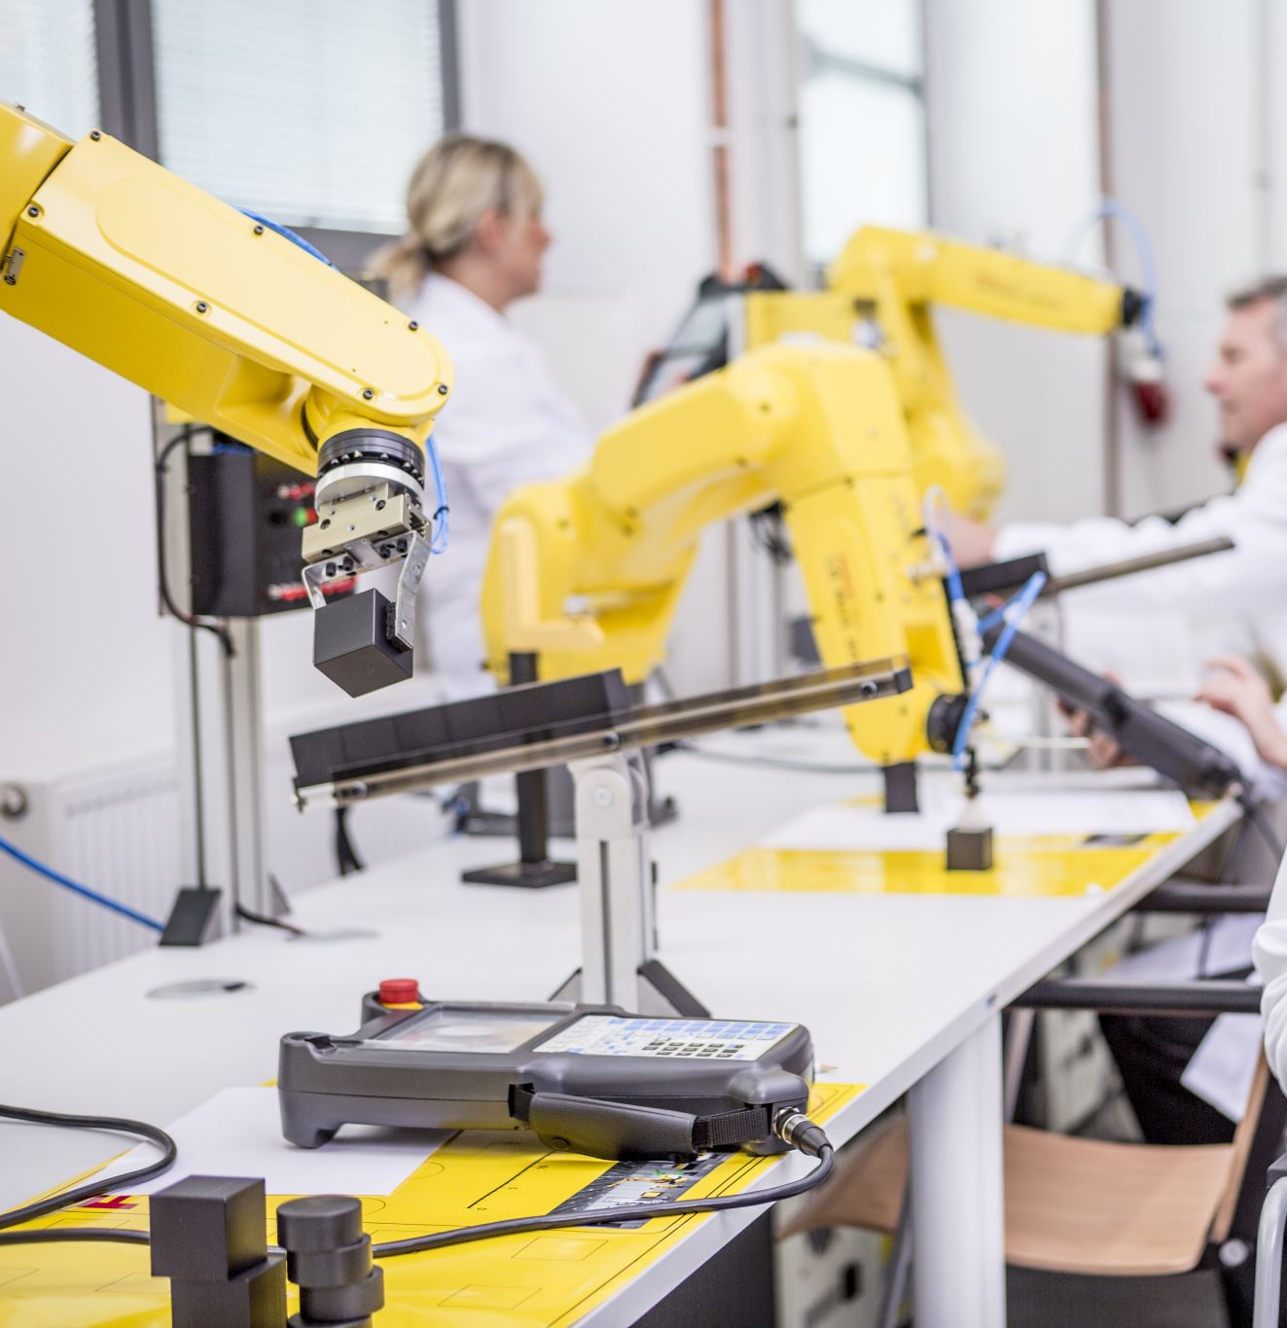
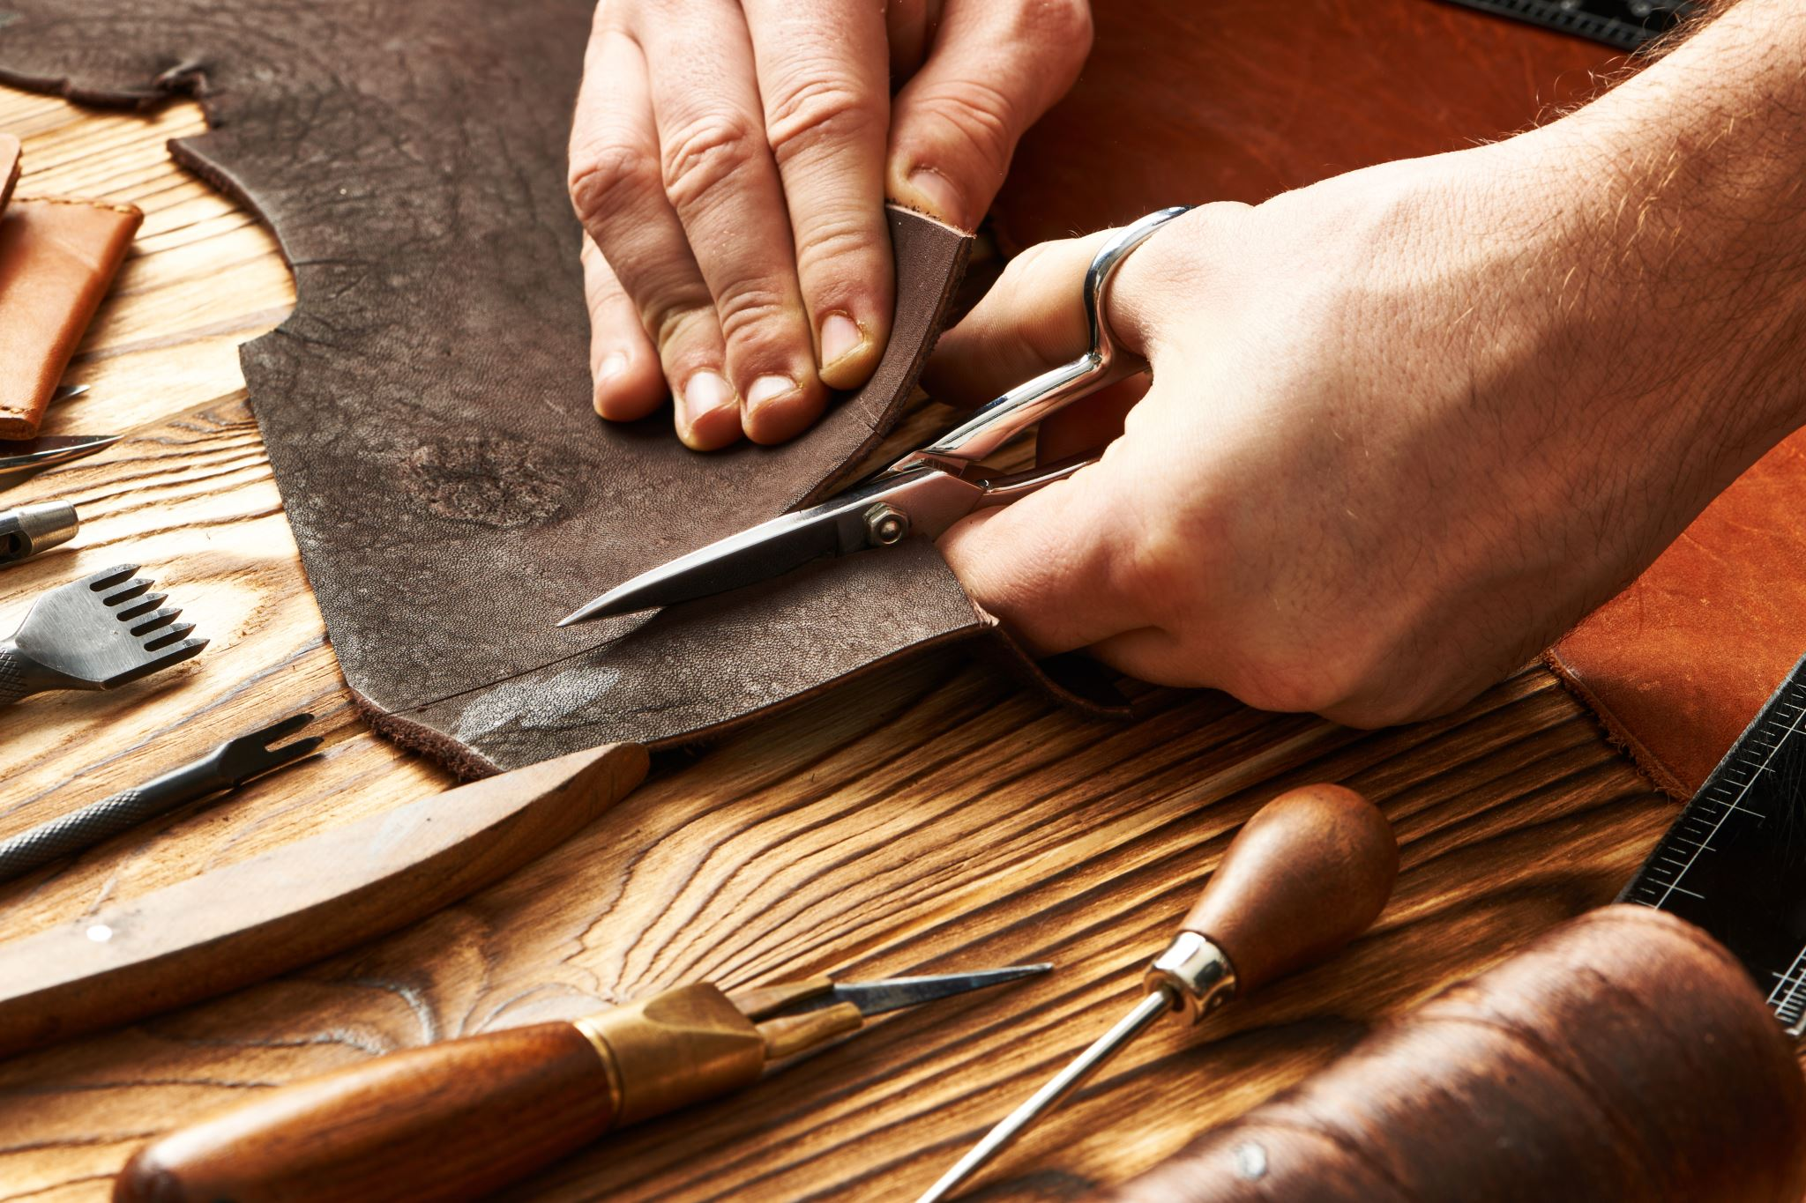


Session 3 – Learning goals
You will be able to:
Identify situations where the dimensions proposed by the paradigms analysed and addressed by tools might reveal useful, together with strategies to promote their
use into organization

