Slide 1
Teaching and learning Activity 2: Knowing basic aspects of HRD
As base for the further discussion of intersections between CGC and HRD, basic aspects of HRD will be presented and reflected. We develop an overview on basic aspects of HRD which can show intersections for CGC.
This license lets you (or other party) share, remix, transform, and build upon this material non-commercially, as long as you credit the Connect! project partners and license your new creations under identical terms.

Slide 2
STEPS TOWARD THE LEARNING GOAL
Step 1
Getting familiar with the HRD Cycle – share your knowledge about major steps and specific aspcts
Step 2
Think about changes in companies and HRD, discuss links between HRD and CGC
Notes:
Introduction and Description of the goal of the session
Teaching and learning Activity 1: Knowing basic definitions of CGC and other “innovative” concepts
Teaching and learning Activity 2: Knowing basic aspects of HRD (connection to unit 2)
Learning Activity 1: Developing knowledge about intersections between CGC and HRD in enterprises
Learning Activity 2: Knowing typical cases of intersection between CGC and HRD in enterprises
Closing thoughts
Homework
Evaluation Level of learning

Slide 3
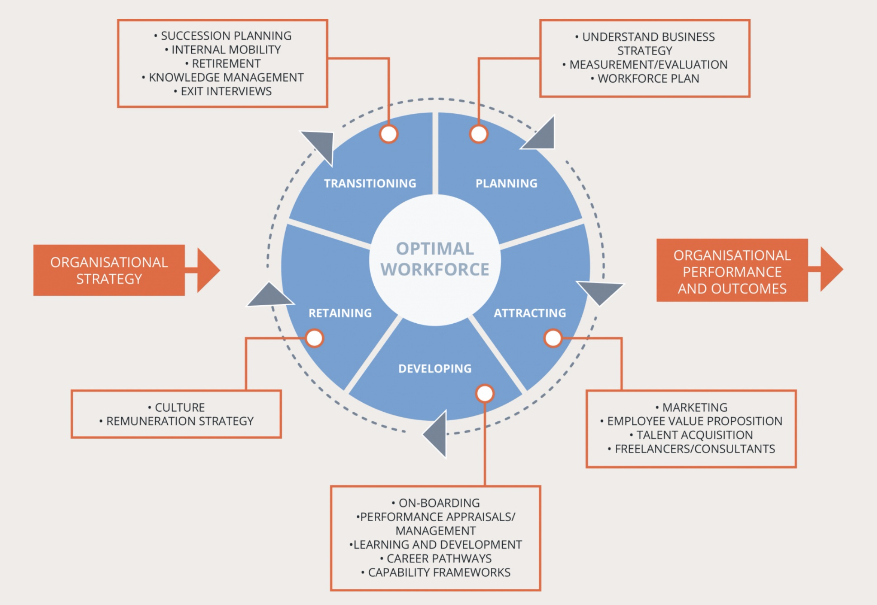
HRD Cycle
The graph is showing the HRD cycle. It is linking personnel to major HRD activities.
We identify intersections between HR-Cycle and Career Counselling
Source: Mona Momtazian, Expert 360,
https://expert360.com/resources/articles/talent-management-important (2020-04-06).

Slide 4
Learning activity 2
Read Material No. 5
Discuss the following question:
Questions for reflection:
Where do you see lines of development in the HRD field?
What are links form HRD to CGC?
Write down your reflections
Use Material No. 05

