Slide 1
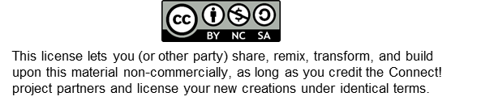
Unit 4
Learning Session 2: Working with different target groups, part 2 (flip chart templates)
Peter Weber, Bettina Siecke, Matthias Varul

Slide 2
Reflect – from Individuals to Groups and Back
my self
my past
my future
Notes:
As a self, you don‘t only exist in the present – you‘ve got a past and a future

Slide 3
Reflect – from Individuals to Groups and Back
my self
my past
my future
Notes:
Your past and your future are not just what your self is in between – they are what your self is made of (i.e. you are your past and your future)

Slide 4
Reflect – from Individuals to Groups and Back
my self
my actual past
my actual future
with all my actual and my potential pasts and futures
Notes:
But not only your actual past – also all the things you could have done or experienced and have not (missed opportunities, evaded dangers) are relevant for your identity. And of course, all the choices and risks that await you in the future are part of who and what you currently are – including that future, which will eventually materialilse

Slide 5
Reflect – from Individuals to Groups and Back
my self
!
UNDER CONSTRUCTION
my actual past
my actual future
with all my actual and my potential pasts and futures
Notes:
And which of the possible futures will materialise is, partly, a matter of the process of career construction…

Slide 6
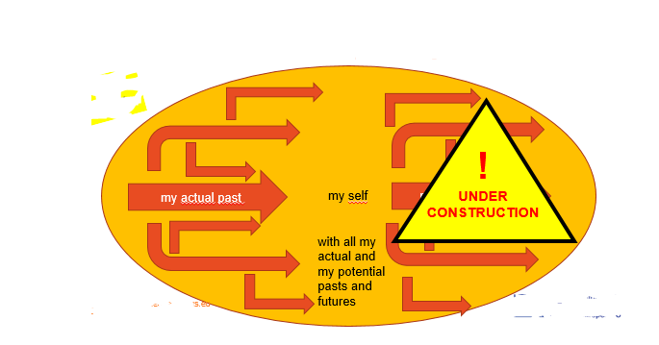
Reflect – from Individuals to Groups and Back
Notes:
But there is more

Slide 7
Reflect – from Individuals to Groups and Back
OTHERS‘ EXPECTATIONS
OPPORTUNITIES
SUPPORT BY OTHERS
CONSTRAINTS
Notes:
The construction of identity takes place under external conditions – some encouraging, facilitating… and others inhibiting and challenging

Slide 8
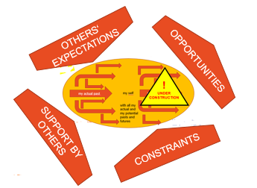
Reflect – from Individuals to Groups and Back
NEURO-DIVERSITY
SEXUAL ORIENTATION
CLASS
AGE
GENDER
DISABILITY
RACE
ETHNICITY
GENDER IDENTITY
RELIGION
PLENTY OF ISSUES – COLLECTIVE EXPERIENCES OF DISADVANTAGE AND DISCRIMINATION
Notes:
And many of these conditions are not mere coincidence but relate to collective experiences of current and historical disadvantage, discrimination and inequity. Some of them we may be free to choose – most of them we are not (even if we should be). This does not mean that we can be reduced to collective identities. For one, most of us have more than one collective identity, collective experience etc. – but crucially, we all process such experiences individually in our construction of selfhood.

