Slide 1
Unit 4
Learning Session 2: Working with different target groups, part 3
Prof. Dr. Peter Weber, Prof. Dr. Bettina Siecke, Dr. Matthias Varul
This license lets you (or other party) share, remix, transform, and build upon this material non-commercially, as long as you credit the Connect! project partners and license your new creations under identical terms.

Slide 2
Why bother? Money and morality!
The social-justice case
The business case
Inequality of opportunity means that people, for various reasons, cannot develop their full potential. This affects their economic situation, their general well-being and health, their self-esteem and their ability to participate in decision-making processes.
This may affect people of colour, women, ethno-religious minorities, people from socio-economically disadvantaged backgrounds, people with disabilities, members of LGTBQ communities – and others.
In democratic societies, such disadvantage is not acceptable.
If employees, for whatever reason, are not able to develop their full potential, this is detrimental to business, because organisations and societies cannot make the best use of their human resources.
Facing the challenges of digitalisation, demographic change, and generally growing uncertainty, leaving human resources un-developed makes even less economic sense today than ever before.

Slide 3
Paying attention – to yourself and to the other
Critical-reflective practice
Attentive counselling
In order to understand individuals you need to understand the difference in collective experiences as well!
Reflect on how your own background impacts on your reception and response to people with other backgrounds
More important to constantly inquire and learn in cooperation than to have fixed knowledges about specific groups
Critical awareness is necessary, but not sufficient!
Work on assumption that people normally have reasons for the way they act, respond, or are inactive and irresponsive
Modify your own approach so you can attend to the target group’s need rather than trying to teach them to adapt to yours

Slide 4
Counselling for specific groups in organisations
A third party on board
Mediation, advocacy and allyship
Access can be a problem – find ways of creating attention to the need (make the business case – but never forget the justice case!) – piggyback CGC on HRD
Know the organisation! It is the main locus of constraints and opportunities. Be conversant in its language!
Be an agent of innovation! If there are no opportunities in the organisation, maybe they can be created?
Be prepared to negotiate conflicts of interest!
Be ready to be part of conversations between employer and employee
Be an advocate where needed – but aim to be an ally at all times – and encourage representation wherever you can

Slide 5
Four examples
Ethnic/racial/religious minorities
1
Low-skill workers
3
2
Older employees
4
Employees with disability

Slide 6
Four examples
Ethnic/racial/religious minorities
3
1
Low-skill workers
1
3
These are only examples – always keep in mind that:
There are many fields we cannot cover here
Fields are never homogenous!
Fields intersect!
Our target is not to instil comprehensive knowledge but to think about how to work with individuals within and between specific groups!
2
2
Older employees
4
Employees with disability

Slide 7
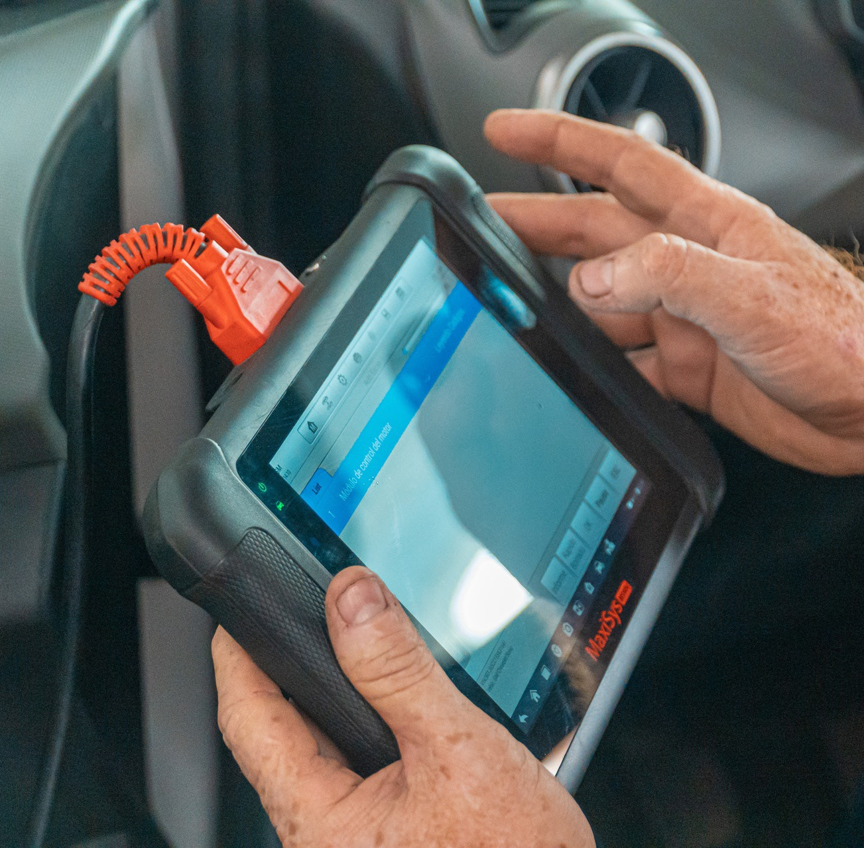
Introduction group work
Connected to your assigned readings you will find a group task sheet – find your team members (who read the same text) – and go to the assigned rooms to do following
Read and discuss the tasks
Carry out the tasks as described (apply what you have learned from the assigned text!)
Return to class to present your results
What are your questions or critical thoughts?

