Slide 1
Career Adaptability
Unit 3​
Session 1
Lea Ferrari
Teresa Maria Sgaramella
This license lets you (or other party) share, remix, transform, and build upon this material non-commercially, as long as you credit the Connect! project partners and license your new creations under identical terms.

Slide 2
Aim of the presentation
Illustrate the notion of career adaptability
Explore the questionnaire
Practice with an example

Slide 3
Adapt-
To bring inner needs and outer opportunities into harmony
Career construction theory conceptualizes human development as driven by adaptation to a social environment with the goal of person–environment integration.
Higher levels of adaptation (adaptation results) are expected for those who are willing (adaptive readiness) and able (adaptability resources) to perform behaviours that address changing conditions (adapting responses).

Slide 4
The Adaptation Model
Adaptability resources
Adaptation outcomes
Willingness to meet career tasks, transitions and traumas with fitting responses
Adaptive behaviours and beliefs that address changing conditions
Self-regulation strengths and capacities
Outcomes of adapting behaviours
Adapting responses
Adaptive readiness

Slide 5
Career Adaptability
Career adaptability is a psychosocial construct that denotes an individual's resources for coping with current and anticipated tasks, transitions, traumas in their occupational roles that, to some degree large or small, alter their social integration (Savickas, 2013).
Career adaptability resources are self-regulation strengths or capacities that shape adaptive strategies and actions aimed at achieving adaptation goals (Savickas, 2013).

Slide 6
The 4Cs of Career Adaptability
1
Career CONCERN
3
Career CURIOSITY
It means essentially a future orientation, a sense that it is important to prepare for tomorrow.
It refers to inquisitiveness about and exploration of the fit between oneself and the work world.
2
Career CONTROL
4
Career CONFIDENCE
It enables individuals to become responsible for shaping themselves and their environments to meet what comes next by using self-discipline, effort, and persistence.
It denotes feelings of self-efficacy concerning one’s ability to successfully execute a course of action needed to make and implement suitable educational and vocational choices.

Slide 7
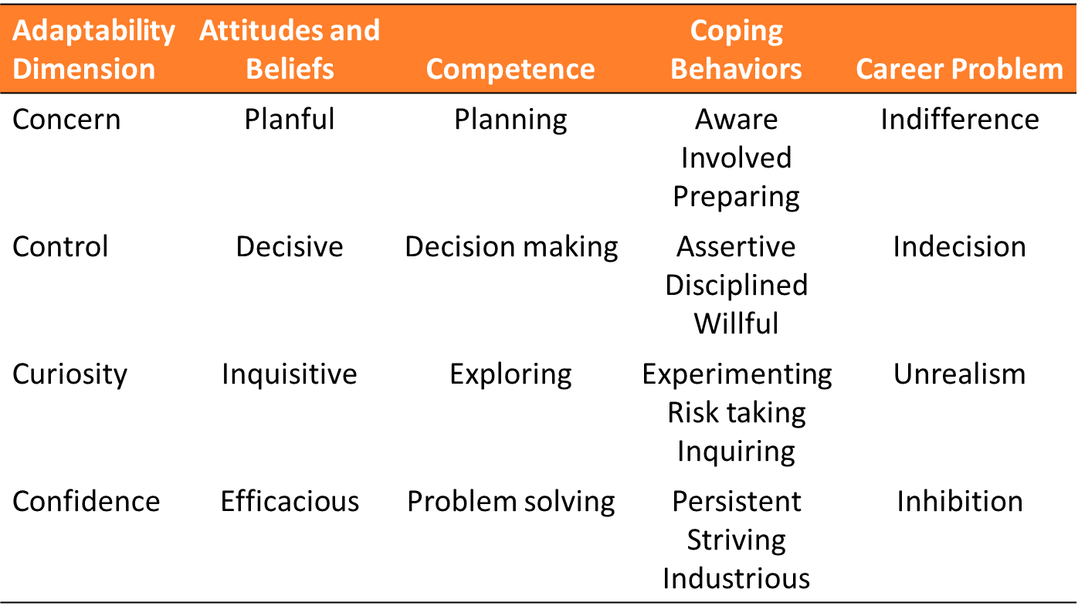
From Savickas, M. L. (2013). Career construction theory and practice. In S. D. Brown & R. W. Lent (Eds.), Career development and counseling: Putting theory and research to work (2nd ed., pp. 147–183). Hoboken, NJ: John Wiley.

Slide 8
Career Adapt-Abilities Scale (CAAS)
Porfeli, E. J., & Savickas, M. L. (2012)
Country | Author | M | SD | α
International | Savickas & Porfeli (2012) | 3.81 | - | .92
Austria | - | - | - | -
Germany | Johnston, Luciano, Maggiori, Ruch & Rossier (2013) | 3.74 | .51 | .94
Greece | Sidiropoulou-Dimakakou, Argyropoulou, Drosos, Kaliris & Mikedaki (2015) | 3.59 | .64 | .94
Italy | Soresi, Nota & Ferrari (2012) | 3.72 | - | .91
Netherlands | Van Vianen, Klehe, Koen & Dries (2012) | 3.76 | .42 | .89
Serbia | Mirković, Suvajdžić, & Dostanić (2020) | 3.08 | .57 | .92
24 items
Likert response format 1= Not strong; 5= Strongest
4 subscales (4Cs) with 6 items each

Slide 9
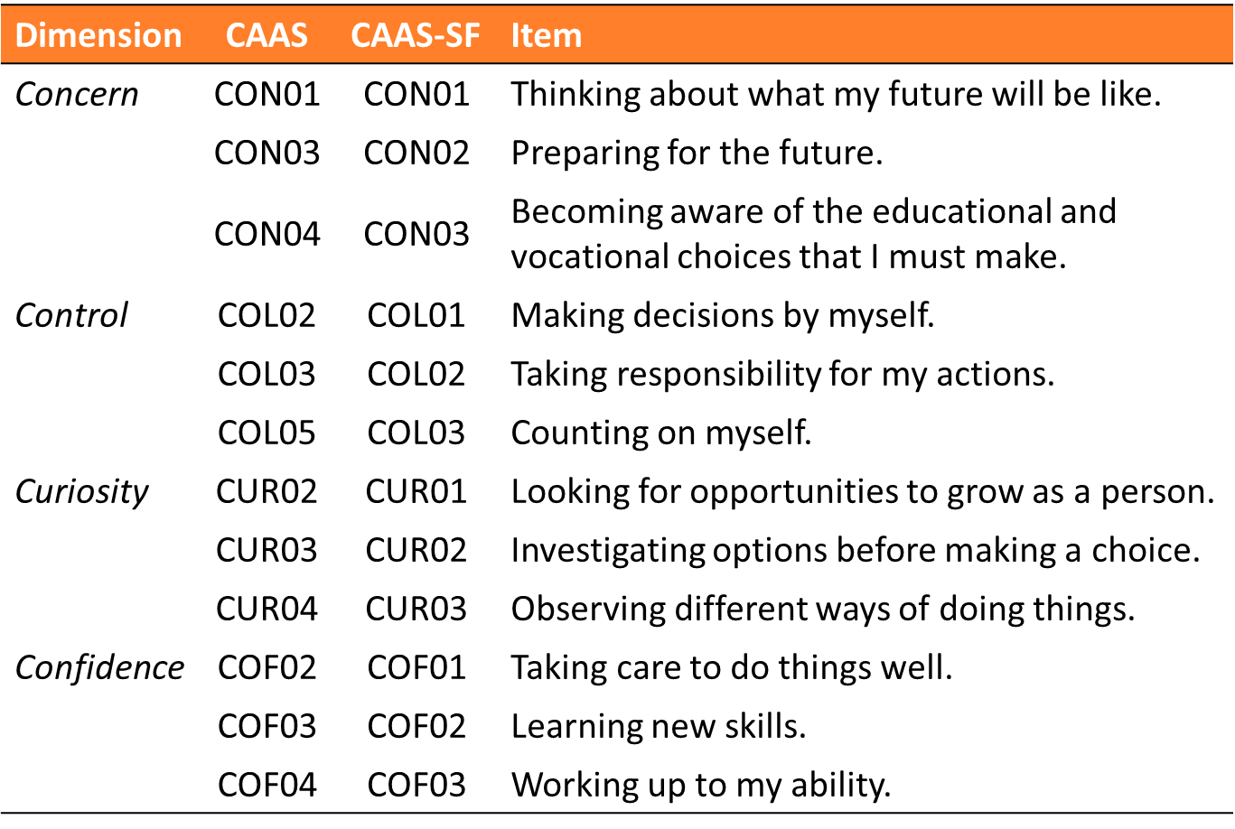
Career Adapt-Abilities Scale Short Form (CAAS-SF)
Maggiori, C., Rossier, J., & Savickas, M. L. (2017)
12 items
Likert response format: 1= Not strong; 5= Strongest
4 subscales (4Cs) with 3 items each

Slide 10
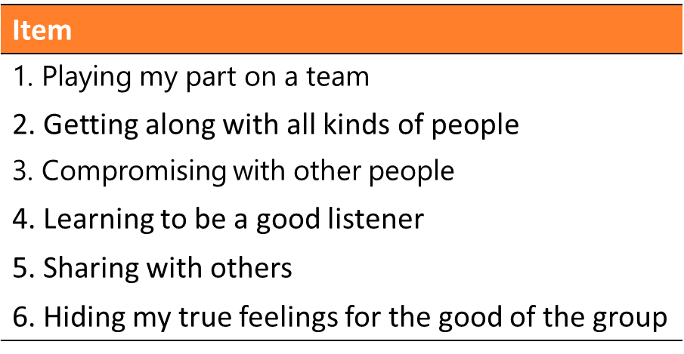
Career Cooperation
The fifth dimension of Career Adaptability (Nye, Leong, Prasad, Gardner, & Tien, 2018)
1
It refers to the ability to successfully interact with and work alongside others.
The authors developed the CAAS–5, adding 6 items to the CAAS (Savickas & Porfeli, 2012).
4

Slide 11
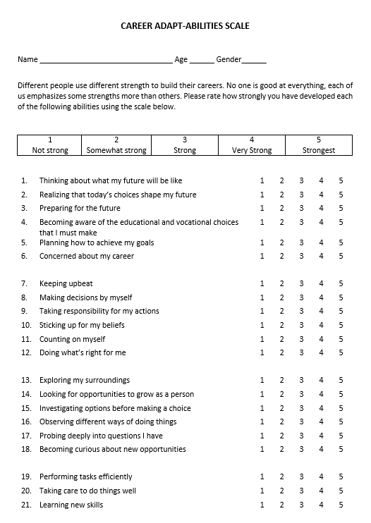
Case Study
Introduction
Women (28 years old)
Career Adapt-Abilities Scale – Five Factor Model (Nye, Leong, Prasad, Gardner, & Tien, 2018)

Slide 12
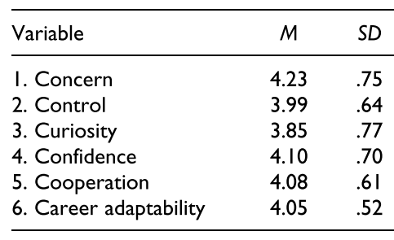
Case Study: scoring
Descriptive statistics of subdimensions among American participants (Nye, Leong, Prasad, Gardner, & Tien, 2018)

Slide 13
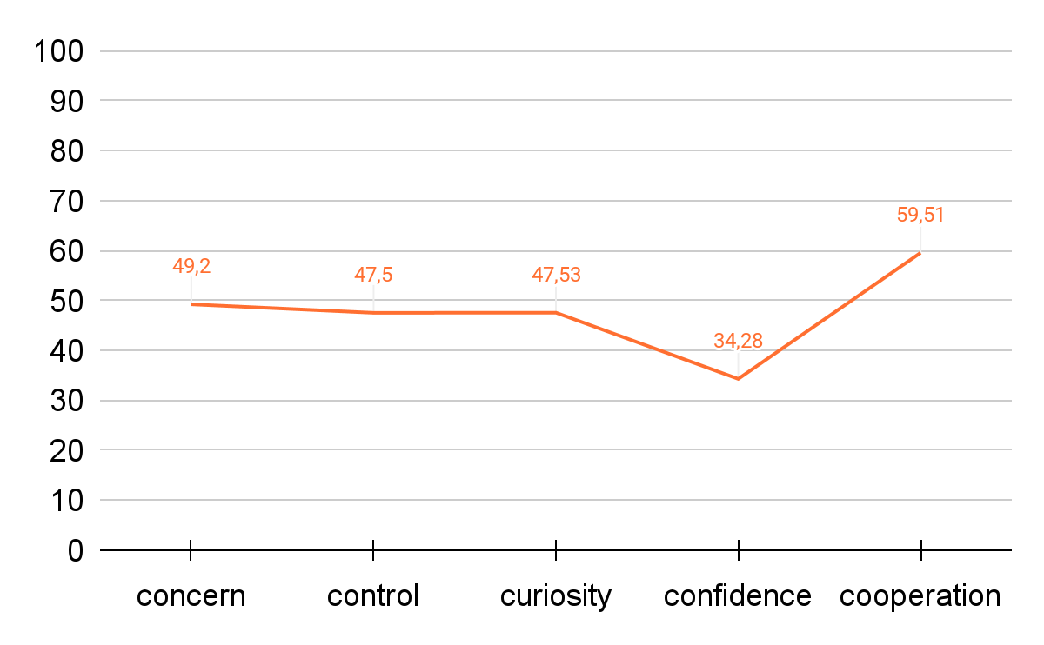
Case Study: How do you interpret the results?
T-scores’ Graphic
Above mean values
Mean values
Below mean values

Slide 14
References
Savickas, M. L. (2013). Career construction theory and practice. In S. D. Brown & R. W. Lent (Eds.), Career development and counseling: Putting theory and research to work (2nd ed., pp. 147–183). Hoboken, NJ: John Wiley.
Savickas, M. L., & Porfeli, E. J. (2012). Career Adapt-Abilities Scale: Construction, reliability, and measurement equivalence across 13 countries. Journal of vocational behavior, 80(3), 661-673.
Nye, C. D., Leong, F., Prasad, J., Gardner, D., & Tien, H. L. S. (2018). Examining the structure of the career adapt-abilities scale: The cooperation dimension and a five-factor model. Journal of Career Assessment, 26(3), 549-562.

Slide 15
summary questions
What is the meaning of ‘adapt-’?
What is career adaptability?
What are the dimensions of the career adaptability?
How can be the collected data analysed and reported?

Slide 16
Questions?

