Slide 1

My System of Career Influences
Unit 3
Session 1
Lea Ferrari​
Teresa Maria Sgaramella
This license lets you (or other party) share, remix, transform, and build upon this material non-commercially, as long as you credit the Connect! project partners and license your new creations under identical terms.

Slide 2
Aim of the presentation
describe the frame and the tool My System of Career Influences (MSCI)
understand the steps in the analysis and the guiding principles
explore some examples

Slide 3
Introduction
Developed and revised by McMahon, Watson and Patton (2013), MSCI is a qualitative guided reflection process for adolescents and for adults.
The MSCI serves as a map guiding the clients throughout the booklet in a step-by-step process of visually representing, elaborating, and reflecting on the holistic pattern of influences on their career development.
MSCI enables users to identify, prioritise and story their career influences, thus enabling them to contextualise career decisions and career transitions.

Slide 4
Systems of influences
Present
Geographical location
Peers
Political decisions
values
gender
Education
institutions
health
sexual orientation
ability
INDIVIDUAL
Family
disability
interests
beliefs
skills
world-of-work
knowledge
Historical trends
Employment
market
personality
age
physical attributes
Workplace
self-concept
Media
aptitudes
ethnicity
Socioeconomic status
Community groups
Globalization
Patton & McMahon (1999)

Slide 5
STF and Career Assessment
Starting point Entering the life space of the client
Outcomes
Story continues
Career action
Story and
Meaning
Career assessment processes
(from McMahon & Patton, 2006, p. 170)

Slide 6
My System of Career Influences (MSCI)
The Guide
 | My present career situation | Ten questions help engage in reflection and discussion about life roles to elicit feelings about making decisions and to compare how decisions were made.
Content Influences
 | Thinking about who I am | Clients are asked to think about what makes them unique and different from someone else and provide examples
Individual System of influences | Thinking about the people around me | Clients are asked to think about people in their lives and how they have been influential and provide examples.
Social system | Thinking about society and the environment | Clients are asked to think about how their decisions may be influenced by the society or environment in which they live and provide examples.
Environmental-societal system | Thinking about my past, present and future, about chance events. | Clients are asked to think about influences related to past, present, future or chance events and provide examples.

Slide 7
My System of Career Influences (MSCI)
The Guide
Process Influences
Past, present, future | Representing My System of Career Influences | Clients combine their examples identified in the previous steps transfer them onto a System of Career Influences diagram.
 | Reflecting on My System of Career Influences | Here clients have the time to think about the System of Career Influences diagram just created.
 | My System of Career Influences | Clients construct a personalized diagram, their System of Career Influences for the current situation.
 | Action plan | Clients are required to think about who they would like to share their MSCI with, and plan steps they will take to assist them in their decision making.
 | My System of Career Influences | Clients may work through the MSCI booklet a second time and, in so doing, they may record similarities and differences in their career influences page by page in their MSCI booklet.

Slide 8
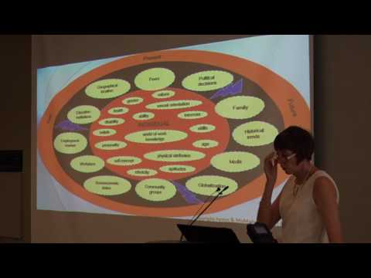
My System of Career Influences (MSCI)
MSCI applications according to learning process
Regardless of whether career development practitioners are working with individuals or in small groups, MSCI learning process can be applied as:
a. Single session process to complete the booklet in 30 – 40 minutes
b. A three session process with each session devoted respectively to the analysis of the current situation; the analysis of the systems of influences; the reflective process about the System of Career Influences diagram and the action plan

Slide 9
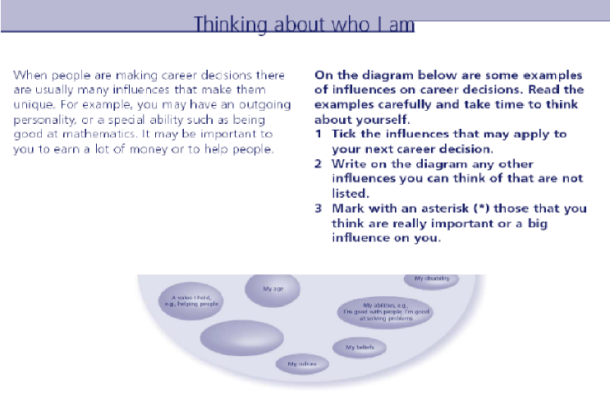
MSCI_ My Systems of Career Influences
Instructions for the first map
(from McMahon & Patton, 2006)

Slide 10
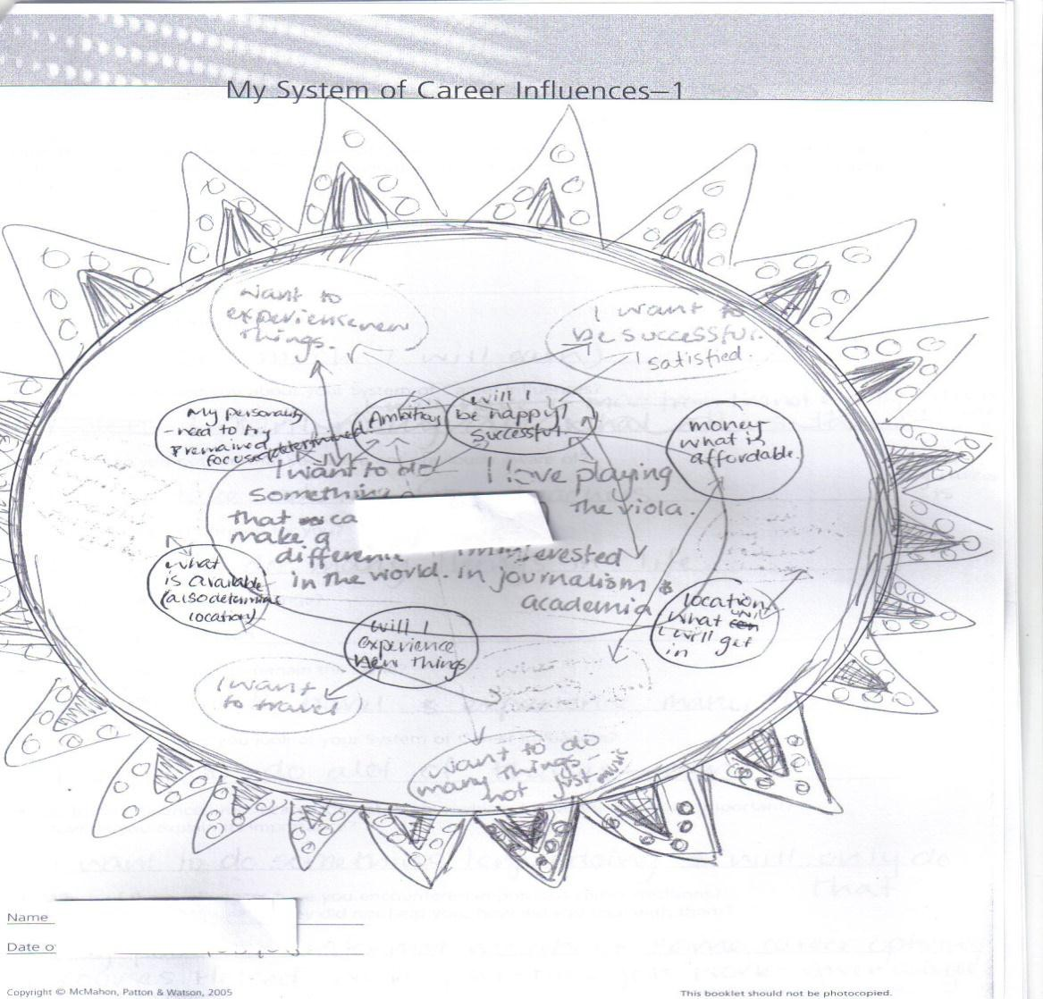
My System of Career Influences (MSCI)
The personal System of Influences: an example
clients “relate the details and reality of their own maps through the telling of their career stories”
(McMahon & Patton, 2006, p. 97; 2016 )
(from McMahon & Patton, 2006, p. 170)

Slide 11
My System of Career Influences (MSCI)
Themes in the analysis of influences
Influences from the individual system – Personal resources and characteristics, values and beliefs, interests, attitudes, and skills that individuals ascribe to themselves.
Influences from the social system – Relationships, such as with their families, peers, and community groups.
Influences from the environmental-societal systems – General conditions (social, economic, geographical ..) in the environmental and the social contexts in the country of living
Influences from past, present, and future – The individual lists past career influences, present circumstances of various origin and anticipates future lifestyle
Personal System of influences on career – From the work on the various systems, the participant selects and uses the most relevant themes.

Slide 12
My System of Career Influences (MSCI)
Voice-centred relational analysis in the analysis of influences
Stage 1, listening for the plot, i.e. how the stories are told by the participant and what is happening, the main events, the actors, and the context in which the plot unfolds.
Stage 2, listening for I-poems, i.e. the voices of the participant, with the purpose of listening to the participants’ first-person voice and how the participants talk about themselves.
Stage 3, listening for relationships, explores each participant’s experience in his or her relational world and way of relating to other people.
Stage 4, listening for the cultural contexts and social structures, that is the role and the influence that cultural norms and societal values play in the narratives of career stories
(Abkhezr, et al., 2018; Magnano et al., McMahon et al., 2019)

Slide 13
The strengths of
My System of Career Influences (MSCI)
The MSCI encourages individuals to
  engage in a reflective process (reflection) …
  tell their stories in relation to the systems of influence within which they live (connectedness)
  begin to understand how identified influences have impacted on their story (meaning making)
  identify themes and patterns evident within and across stories (learning)
  play a more active role in constructing their future identities and career stories (agency)
(McMahon, Patton, & Watson, 2015, p. 151)

Slide 14
MSCI Example 1
Client’s description (1)
Rossana is a 24 year-old woman with 8 years of education.
In her past there are several different jobs: clerk in various shops, babysitter and waitress during summer.
Currently, she is involved in a career counseling program

Slide 15
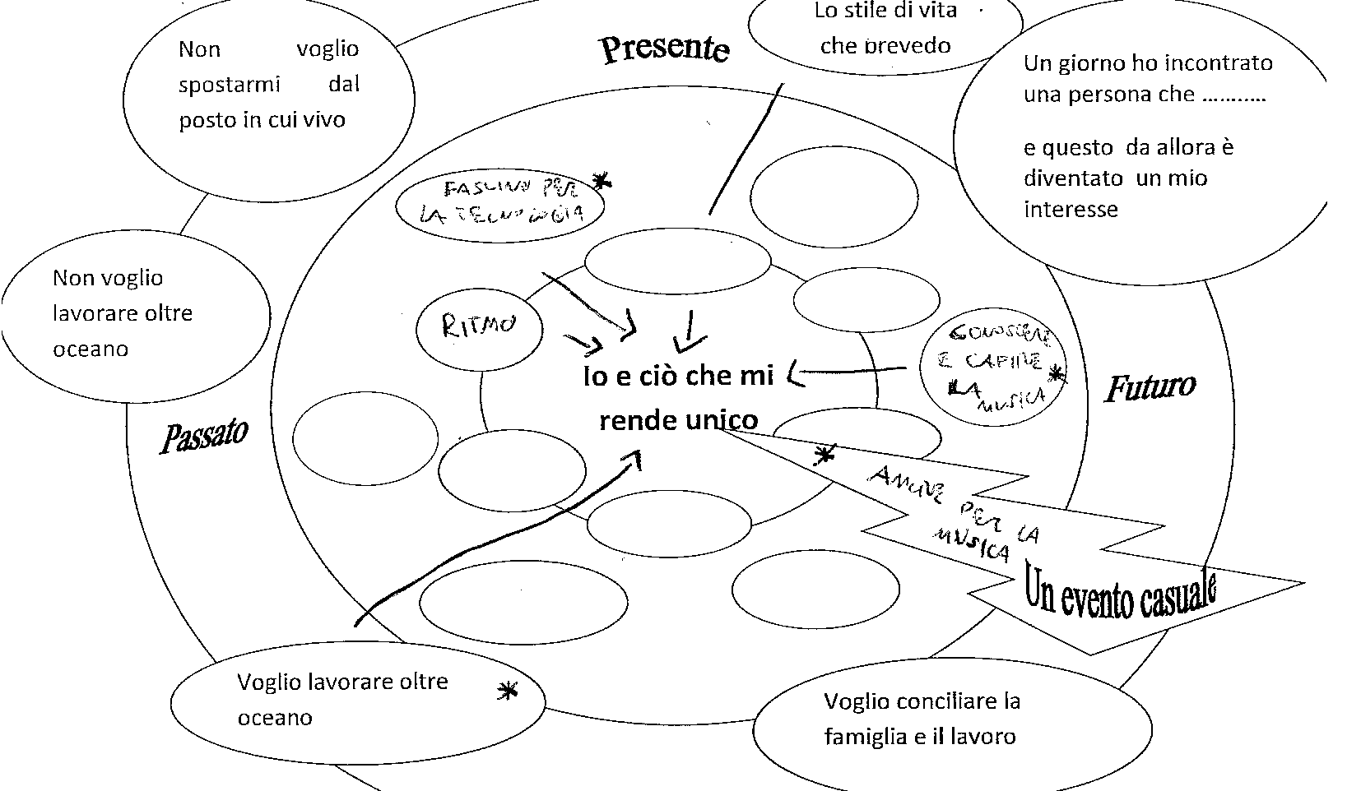
MSCI Example 1
Rossana : her map of her System of Career Influences
Thinking about my past, present and future.
She does not mention events in her past except for her interest in travelling and searching for a work abroad
She focuses on her interest in technology, on the rhythms.
She mention a chance event that made her discover her interests for music (namely, during the discussion with participants in the career counseling program)
In her future, in fact, she underlines her interests learning and understanding music.

Slide 16
MSCI Example 1
Rossana: heer Action Plan
Answering the final questions, she lists the following actions:
«I will talk about my projects with my family, I think they will support me.
I will search for training courses on internet and I will go to the radio station in my town to ask people that work there, where they were trained.»

Slide 17
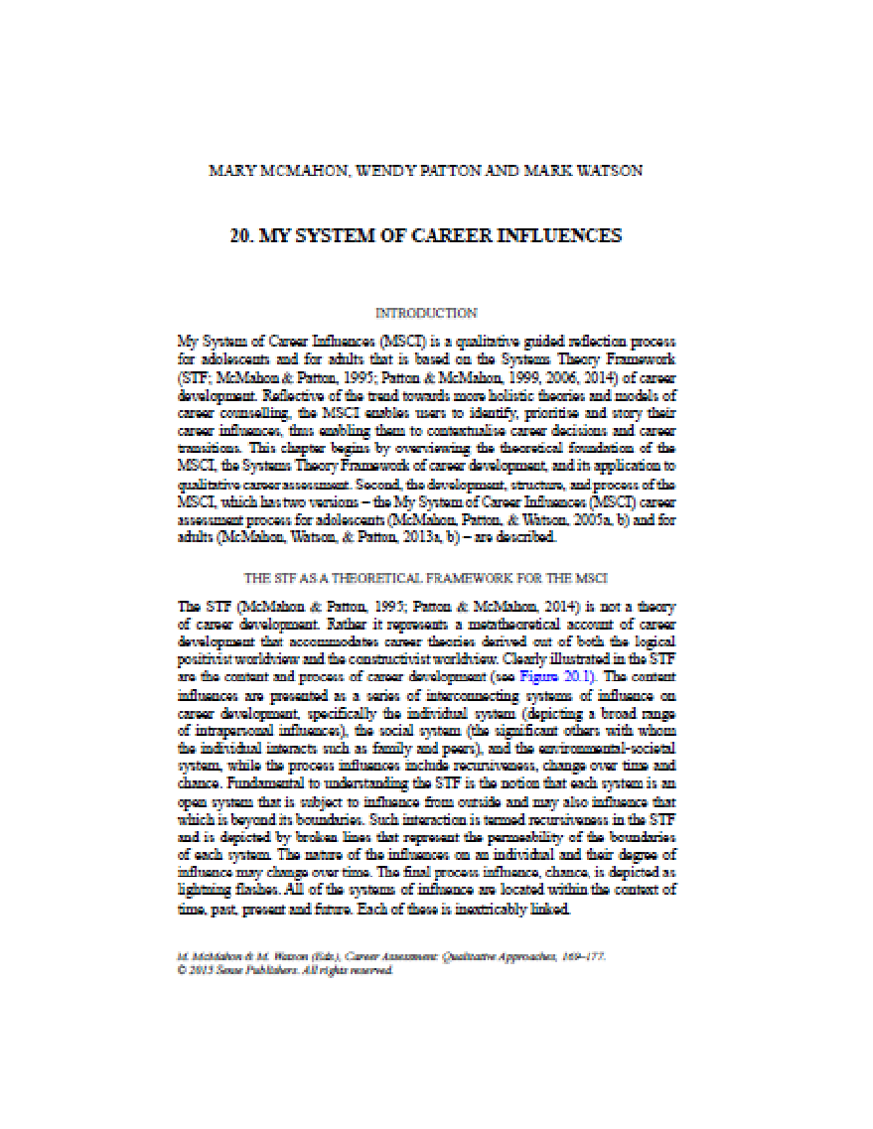
Case Studies (1/2)
Two stories
McMahon, M., Patton, W., & Watson, M. (2015). My system of career influences. In Career Assessment (pp. 169-177). Sense Publishers, Rotterdam.

Slide 18

Case Studies (2/2)
Four stories
Magnano, P., Zarbo, R., Zammitti, A., & Sgaramella, T. M. (2020) Approaches and strategies for understanding the career development needs of migrants and refugees: the potential of a systems-based narrative approach.
International Journal for Educational and Vocational Guidance, 1-21.

Slide 19
MSCI
Some references
McMahon, M., & Patton, W. (2006). The Systems Theory Framework: A conceptual and practical map for career counsellors. In M. McMahon, & W. Patton (Eds.), Career counselling: Constructivist approaches (pp. 94–109). London, UK: Routledge.
McMahon, M., Watson, M., & Patton, W. (2013). My System of Career Influences (MSCI): Adult Version. Facilitators’ Guide. Samford, Australia: Australian Academic Press.
McMahon, M., Watson, M., & Patton, W. (2013). My System of Career Influences (MSCI): Adult Version. Workbook. Samford, Australia: Australian Academic Press.
Patton, W., & McMahon, M. (2014). Career development and systems theory: Connecting theory and practice (3rd ed.). Rotterdam, The Netherlands: Sense.

Slide 20
Summary questions
What are the Systems of influences?
What is My System of Career Influences (MSCI)?
What are the steps to be followed in analysing the data collected with the MSCI?
What are the strengths of the MSCI?

Slide 21
Thank you for the Attention

