Slide 1
Unit 5 Change in Organizations
Learning Session 1
Change Management & Organizational Development
This license lets you (or other party) share, remix, transform, and build upon this material non-commercially, as long as you credit the Connect! project partners and license your new creations under identical terms.

Slide 2
What will we cover today?
1.1. What are CM and OD?
Definitions of Change Management and Organizational Development
How do they differ? Is there an overlap?
Employee VS Organizational Development
1.2 Theories of Change Management
Classic theories of Change Management
Basic principles of Change Management – Resistance to Change
Learning to think critically!
1.3. Summary

Slide 3
What is Change Management?
“the leadership and direction of the process of organisational transformation – especially with regard to human aspects and overcoming resistance to change” (Fincham, & Rhodes, 2005, p. 525)
“the process of achieving the smooth implementation of change by planning and introducing it systematically, taking into account the likelihood of it being resisted” (Armstrong, & Taylor, 2014, p. 424)

Slide 4
What is Organizational Development?
It is work within an organization to understand how things are working, and see whether it is achieving its missions and goals.
It is primarily diagnostic work which focuses on unveiling what is happening inside the organization.
It is a critical and science-based process that helps organizations build their capacity to change and achieve greater effectiveness by developing, improving, and reinforcing strategies, structures, and processes (Cummings, & Worley, 2009)

Slide 5
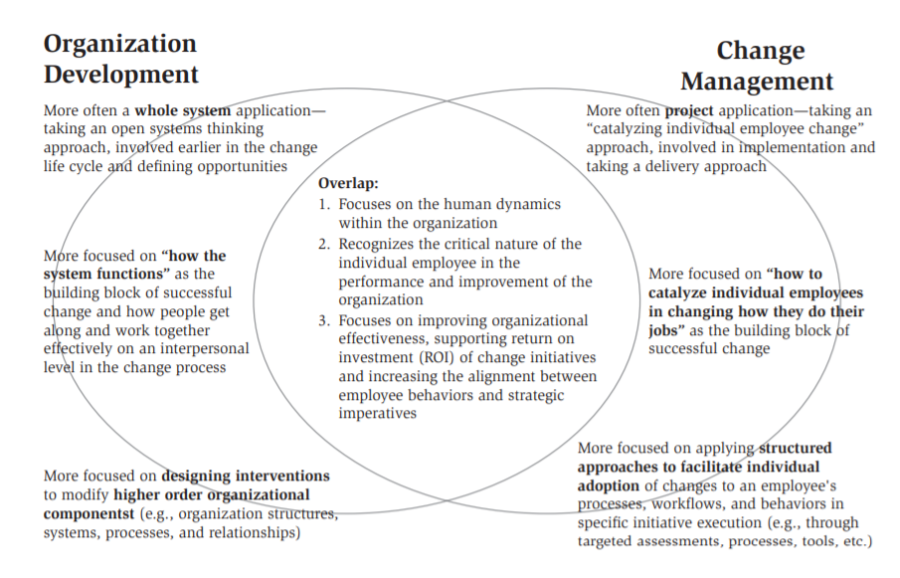
Similarities-Differences between CM & OD
Organizational Development work typically takes place before Change Management
Change Management is the way through which the goals identified by OD can take place smoothly and successfully
Creasey, Jamieson, Rothwell, & Severini, 2015.

Slide 6
Employee VS Organizational Development
Employee Development= Refers to the resources an employer provides to workers so they can acquire new skills or perform better. By aiding employees to grow their skills, knowledge, and task performance, the employer aims towards improving the organization’s efficiency, innovation, and overall prosperity.
Organizational Development= It is a management planned, entity-wide process of organizational evolution focused on improving a business’s effectiveness and profitability through the application of behavioural-science knowledge.

Slide 7
Let’s think!
Discuss the following with your team:
Is there an overlap between these two types of development?
Do they differ in how the organization is benefited?
Are there any hidden risks or challenges?

Slide 8
Employee VS Organizational Development
Development Overlap
Both include education as an important component
Employee development allows the worker a certain amount of freedom in choosing what to pursue, whereas organizational development requires employees to follow a specific plan.
Organizational development is focused on developing the business in specific ways, so employees must “conform” to the organization’s developmental goals.
Employee development is general, whereas OD is targeted.
Risks and Challenges
Risk of time, money, and loss of employees
ED is time intensive, which means employees have less time to produce for the employer (short-term decrease in productivity).
Developing an employee’s skill set makes them more valuable to competitors. This increases the risk that an employee could leave for other opportunities (loss of investment).

Slide 9
Theories of Change Management
Lewin’s (1951) three-step model of change
Kotter’s (1995) eight-step model of change
Nudge Theory (2008)
Adopting a critical perspective

Slide 10
Kurt Lewin – Three-Step Model (1)
Developed the theory in 1951
Still is one of the most well-known and quoted CM theories
Basic principle= the driving forces must outweigh the resisting forces in any situation if change is to happen
Force field analysis → every change situation has driving and resisting forces
Driving forces (positive elements towards change)
What needs to be changed
Resisting forces (negative elements towards change)

Slide 11
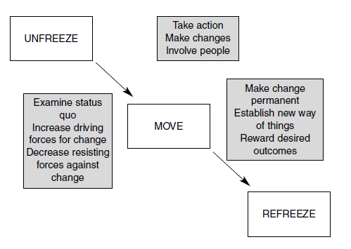
Kurt Lewin – Three-Step Model (2)
UNFREEZE= Define the current state, surface the driving and resisting forces, and picture a desired end state.
MOVE= Moving to a new state through participation and involvement.
REFREEZE= Refreeze and stabilize the new state of affairs by setting policy, rewarding success and establishing new standards.
Organizations as homeostatic organisms → tendency of an organization to maintain its equilibrium in response to disrupting changes (natural tendency to adjust itself back to its original steady state)

Slide 12
Kurt Lewin – Three-Step Model (3)
Advantages
Disadvantages
Easy to understand (no need to train employees, principles are straight-forward)
It focuses on behaviours (easily gets to the heart of what causes people to either resist or support change)
The model makes sense to many people. Its simplicity leads to better understanding of CM, without getting lost in jargon
Not detailed enough (its simplicity means it can be interpreted in a variety of ways)
It is rigid, and does not reflect modern times (the fast-paced advancement of technology means that the “frozen” behaviors will need to be “unfrozen” quite often)
May be seen as combative, instead of nurturing (it focuses on disrupting the equilibrium, instead of fostering a nurturing environment)

Slide 13
John Kotter– Eight-Step Model (1)
He developed the theory in 1995
Based it on his personal consulting experience (>100 organizations)
The model puts emphasis on:
1. Issues of power
2. Importance of “felt need” for change
3. Communicating the vision
4. Encouraging active channels of communication
He visualized change as an eight-step process

Slide 14
John Kotter– Eight-Step Model (2)
1. Establish a sense of urgency: Discuss today’s competitive realities, investigate future scenarios, increase the ‘felt-need’ for change.
2. Form a powerful guiding coalition: Get the right people on the team by selecting a mix of skills, knowledge and commitment.
3. Create a vision: Create a correct vision by taking into account, not just the strategy, but also creativity, emotional context, and objectives.
4. Communicate the vision: Must be systematic and thorough
5. Empower others to act on the vision: Get rid of obstacles to change, such as unhelpful structures or systems, provide feedback, and allow people to experiment.
6. Plan for and create short-term wins: Look for and advertise short-term visible improvements. Plan these in and reward people publicly for improvements.
7. Consolidate improvements: Promote and reward those able to promote and work towards the vision. Energize the process of change with new projects, resources, change agents.
8. Institutionalize new approaches: Make these changes a part of the corporate culture.

Slide 15
John Kotter– Eight-Step Model (3)
Advantages
Disadvantages
Its step-by-step nature makes it easy to follow, apply, and incorporate into organizational processes.
The first three steps set the organization up for success. The sense of urgency pushes things into motion, thus ensuring the momentum towards the objective.
Emphasizes importance of getting help and motivating. Importance of assembling a coalition of diverse leaders and change agents.
Too focused on urgency, lacking detail in how to accomplish each step separately.
Steps sometimes feel like they are not in the proper order. The lack of overarching themes leads to lack of cohesion
It is top-heavy, meaning that it places greater emphasis on leaders rather than individual employees.
Might encourage is an early burst of energy, followed by delegation and distance.

Slide 16
Let’s think!
Looking at Kotter’s model and the eight steps towards effective change, how do you think resistance may manifest in each stage?

Slide 17
Sunstein & Thaler – Nudge Theory (1)
They developed the theory in 2008 (behavioural economists)
Nudge theory is one of the most contemporary and relevant to change management
For change to be successful, we must understand why human behaviour changes, and what motivates people to adopt change
Nudge= a small action which can influence how people decide and behave
Encourages indirect techniques of influencing behaviour, rather than direct instructions
By providing choices and fostering an enabling and encouraging environment, change in employee behaviour will take place

Slide 18
Sunstein & Thaler – Nudge Theory (2)
Types of Nudges
Perception nudges= These are actions which play around perceptions of organisational behaviour. Understanding employees’ perceptions of the desired change is critical for success → can also reveal possible resistance
Motivation nudges= These are actions which are needed to make employees care about an upcoming change.
Simple, Ability-enabling nudges= When change is hard, complex, and difficult to adopt, simple and tiny actions can improve employees’ change adoption ability.

Slide 19
Sunstein & Thaler – Nudge Theory (3)
Clearly define change
Inclusive decision-making
Receptive to feedback
Remove bottlenecks
Stay consistent
Stakeholder analysis
Create a timeline
Benefits
Minimizes resistance to change
Takes into account the difference in feelings, opinions, and knowledge of people
Eliminates traditional change methods (e.g., punishment and direct instructions)
Is applicable in several industries
Steps to achieve change
Criticisms
Issues of moral decision-making. who decides what is good or bad to nudge/alter?
Is it a manipulation on the freedom of choice? Nudges affect our behavior without us necessarily realizing it

Slide 20
Let’s take a deeper look…
Critical Theory
It assumes that a reality exists, but it has been shaped by cultural, political, ethnic, gender and religious factors which interact with each other to create a social system.
No object can be researched without being affected by the researcher
Knowledge endorsed by those in power is to be viewed critically
The rules that legitimatize some bodies of knowledge and delegitimize others should be questioned.
What it means to think critically

Slide 21
Critical Theory…what does it mean for change work?
We should ask ourselves: “How did I get stuck with this body of knowledge and these lenses through which to see the world?” (Kincheloe, 2008, p.21).
Provides us with a lens to view conflict and power which traditional change theories tend to leave untouched
Helps unearth assumptions, unconscious biases, and the role of power that are inherent in change

Slide 22
Summary
CM and OD
Employee VS Organizational development
What are they?
How do they overlap?
Are there risks and challenges?
What are they, and do they overlap?
Are there risks and challenges?
Change Theories
Critical Theory
Lewin’s three-step model
Kotter’s eight-step model
Nudge Theory
Benefits-Drawbacks of each theory
Basic principles
How can it help us become better at implementing change?

Slide 23
Homework
1. There are many approaches to managing change. Find and briefly describe a theory of change management which you consider interesting or innovative.
2. How can you apply a critical perspective to that theory?

Slide 24
References
Armstrong, M., & Taylor, S. (2014). A Handbook of Human Resource Management Practice. Kogan Page Limited.
Creasey, T., Jamieson, D. W., Rothwell, W. J., & Severini, G. (2015). Exploring the Relationship between Organization Development and Change Management. In Practicing Organization Development: Leading Transformational Change: Fourth Edition (pp. 330–337). Wiley Blackwell. https://doi.org/10.12/9781119176626.ch22
Cummings, T. G., & Worley, C. G. (2009). Organization Development and Change. South-Western/Cengage Learning.
Fincham, R., & Rhodes, P. (2005). Principles of organizational behaviour. OUP Catalogue.
SHRM. Introduction to the Human Resources Discipline of Organizational and Employee Development. Retrieved from: https://www.shrm.org/ResourcesAndTools/tools-and-samples/toolkits/Pages/introorganizationalandemployeedevelopment.aspx

Slide 25
Thank you for your attention! Any questions?
your@email_address.eu

