Slide 1

Unit 2 : Part 2
Commitment to Corporate Social Responsibility (CSR)
Filiz Keser Aschenberger, Monika Petermandl, Klausjürgen Heinrich
This license lets you (or other party) share, remix, transform, and build upon this material non-commercially, as long as you credit the Connect! project partners and license your new creations under identical terms.

Slide 2
Overview on challenge 2:
Corporate Social Responsibility
At the end of this part you will be able to
explain corporate social responsibility as a driver in our society
identify the role of HR professionals for CSR
describe examples of successful social responsibility activities in enterprises

Slide 3
Conceptual Framework
Definitions
Corporate Social Responsibility (CSR) is an umbrella term to describe how business firms, small and large, integrate social, environmental and ethical responsibilities to which they are connected into their core business strategies, structures and procedures within and across divisions, functions as well as value chains in collaboration with relevant stakeholders (Wickert & Risi, 2019, p. 1).
It is not anymore about how the money is spent but how the money is made (Wickert & Risi, 2019, p. 1).

Slide 4
Definition
From EU Green Paper
  CSR is a concept whereby companies integrate social and environmental concerns in their business operations and in their interaction with their stakeholders on a voluntary basis (Green Paper, Commission of the European Communities, 2001, p. 6).
  CSR provides the foundations of an integrated approach that combines economic, environmental and social interests to their mutual benefit.
  It opens a way of managing change and of reconciling social development with improved competitiveness.
  Being socially responsible means not just fully meeting legal expectations, but also going beyond compliance by investing “more” into human capital, the environment and their relations with stakeholders.

Slide 5
Conceptual Framework
Related Concepts
CSR
Business ethics
Ethical stakeholder behavior
Good corporate governance
Corporate social performance
Corporate sustainability
Corporate citizenship
Stakeholder approach
Corporate account-ability

Slide 6
Motives for CSR
Two main motives
  Ethical motives (intrinsic)
    Promoting social innovation, cohesion, inclusion and sustainability
  Instrumental (extrinsic) motives
    to attract talent, increase employee engagement, motivation and satisfaction, and reduce employee retention, all of which would ultimately contribute to job performance and productivity.
    to enhance trust and support of consumers and investors in products and brands. This allows for creating a favourable reputation, increased sales, and the ability to charge a price premium for socially responsible and sustainable products.
    to reduce costs. For instance, the implementation of eco-efficiency or recycling measures leads to energy savings and reductions in waste and raw materials used.
    to achieve more effective management of environmental and social risks.
    to contribute to a company’s competitiveness (Wickert & Risi, 2019, pp. 25-31).

Slide 7
Impact of Social Responsibility
An organization’s performance on social responsibility can influence, among other things:
  Competitive advantage
  Reputation
  The ability to attract and retain workers or members, customers, clients and users
  The maintenance of employee morale, commitment and productivity
  The perception of investors, owners, donors, sponsors and the financial community
  Relationships with companies, governments, the media, suppliers, peers, customers and the community in which it operates (ISO 26000)

Slide 8
CSR & HRM Relationship
Trends in CSR–HRM research with regard to the CSR and HRM relationship. Voegtlin & Greenwood (2016)
CSR and HRM relationship | Specifications
HRM as a component of CSR HRM as an element of CSR. CSR as the focus of the research | HRM as antecedent to CSR “Human resources” (i.e. workers) and human resource management as enabling of CSR in the organization HRM as subset of CSR HRM is one of several factors that make up CSR.
CSR as a component of HRM CSR as an element of HRM. HRM as the focus of the research | CSR as enabling “effective” HRM CSR is used to achieve HRM goals (e.g. improving recruitment or mitigating regulation). CSR as enabling “responsible” HRM CSR is considered a means for ensuring responsible management of workers.
CSR and HRM as mutually dependent Both CSR and HRM are the focus of the research | CSR and HRM present but no overlap CSR and HRM both identified as subjects but discussed in parallel (e.g. both are variables of another construct). CSR and HRM in interaction CSR–HRM as a complex and rich interactive phenomena. Workers, worker representatives, and those who manage workers, are actors in networks involving multiple stakeholders and institutions.

Slide 9
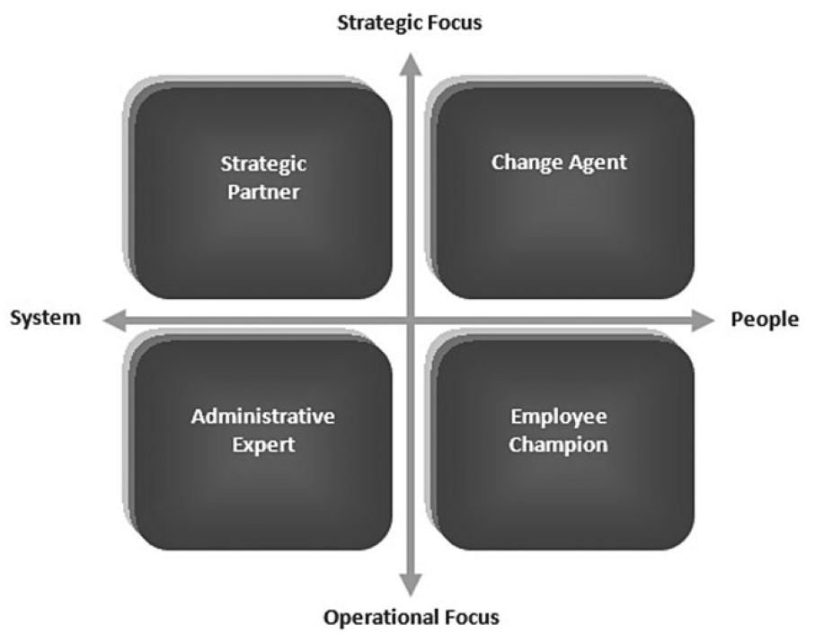
Role of HR in CSR
Strategic human resource management (HRM) partnership model (Jamali et al. 2015, p. 130)

Slide 10
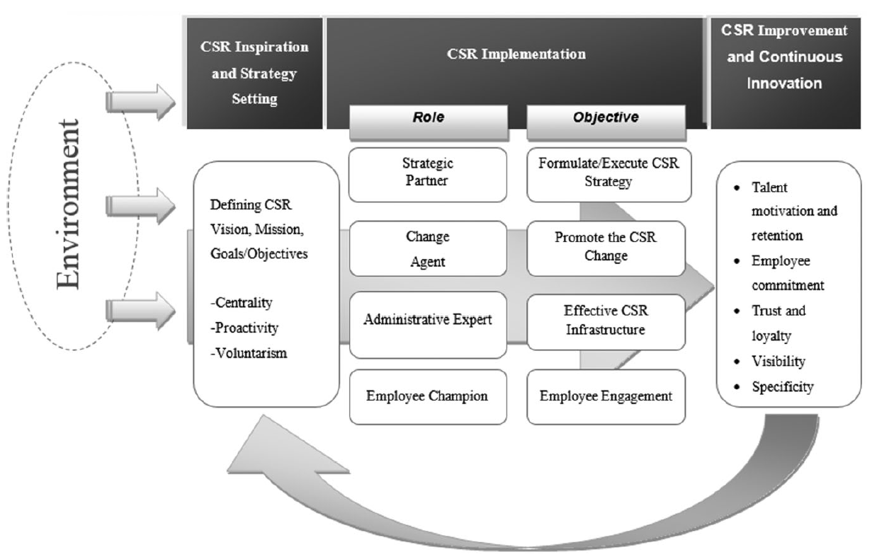
Domains of Contributions
The CSR-HRM Co-creation Model
The model maps the HRM roles over three important milestones of a typical strategic CSR lifecycle namely,
  (1) the inception and strategy setting phase;
  (2) enacting CSR implementation;
  (3) engaging in learning and improvement through continuous assessment of outcomes
Jamali et al., 2015, p. 133

Slide 11
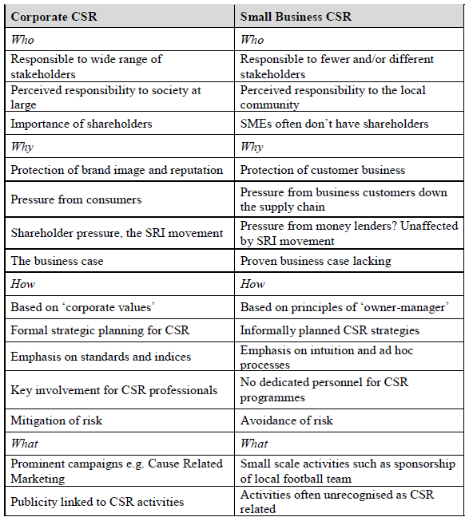
CSR in SMEs
CSR may differ in SEMs
In the crucial who, why, how and what of CSR, SMEs response may differ due to cultural differences created by diverse ownership structures, strategic direction, owner-manager characteristics and geographic location.
Large companies are usually very aware of their CSR, while small companies may be carrying out CSR without recognizing it as such.
There are many opportunities for SME managers to embrace the CSR agenda as they are more flexible, more responsive and better at internal communication. (Jenkins, 2004, p. 51)

Slide 12
Global and EU Principles & Guidelines
Some common & important guidelines
  EU Green Paper
  UN Global Compact Principles
  ISO 26000- Guidance on Social Responsibility
  OECD- Guidelines for Responsible Business

Slide 13
Thank you for your attention.
We are looking forward to your comments and your questions.

