Slide 1
Unit 5 Change in Organizations
Learning Session 2
Organizational Change Cycle
This license lets you (or other party) share, remix, transform, and build upon this material non-commercially, as long as you credit the Connect! project partners and license your new creations under identical terms.

Slide 2
What will we cover today?
2.1. What is a Needs Assessment Analysis?
Definition of needs analysis
How do we conduct it?
Tools and methods
2.2. How do we implement change?
Steps to implementing change
How do we ensure success?
2.3. How do we sustain and evaluate change?
Sustain and evaluate change effectiveness
Cyclic nature of change

Slide 3
What is the change cycle?
Needs Assessment
Implement Change
Evaluate Change
Sustain Change

Slide 4
What is a Needs Assessment? (1)
You may also see it as: “gap analysis”, “needs analysis”, and “performance analysis”
Gaps (either as opportunities or problems) → common instigators of action and change
Identifying the gap between “where we are now” and “where we want to be” is crucial !!!
Benefits are:
(a) systematic process to guide decision making
(b) provide justification for decisions before they are made
(c) can be scalable for any size project, time frame, or budget
(d) can offer a replicable model that can be applied by novices or experts.

Slide 5
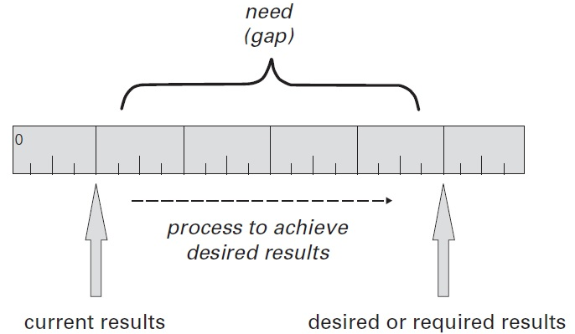
What is a Needs Assessment? (2)
It’s simply a tool for making better decisions!
One could also define it in terms of gaps in results (Kaufman, Oakley-Brown, Watkins, & Leigh, 2003)
Need= the difference between your current achievements and your desired accomplishments

Slide 6
Conducting a Needs Assessment Analysis (1)
Step 1: IDENTIFY
Identify your internal and external partners for the needs assessment.
Determine what data are required to identify needs at the strategic, tactical, and operational levels.
Determine potential sources of data.
Collect information (interviews, surveys, focus groups etc.)
Define the final needs on the basis of gaps between current and desired results.
Step 2: ANALYZE
Establish an initial prioritization of needs
Focus on the high-prioritization needs and see what works and what does not
Analyze and synthesize the useful information

Slide 7
Conducting a Needs Assessment Analysis (2)
Step 3: DECIDE
Making complex decisions based on the analysis is the next and final step.
This step is also often the hardest, since:
there are competing interests for certain types of change to occur
it is hard to agree on which criteria to use in making the decisions
one might have to negotiate and/or compromise

Slide 8
Needs Assessment Tools
Can be summed up into two main categories:
Data collection tools and techniques
Decision-making tools and techniques

Slide 9
Needs Assessment Tools
Some examples of tools and methods are…
Reviewing already existing data/documents
Guided expert reviews
Managing focus groups
Conducting Interviews
Dual-Response surveys
SWOT+ analysis
Observational data
Task Analysis
Let’s think!
What problems could arise if we skip the needs assessment analysis when planning for change?

Slide 10
Implementing Change (1)
Which are the secrets of successful change implementation? McKinsey & Company
Survey of 2000 executives in more than 900 companies across all industries
1. Ownership and Commitment
Leaders must show a high level of psychological investment that drives personal, and proactive action
Successful change reinforces ownership through clear accountability for specific targets
Good Leadership Style: Foster a leadership style that sets bold aspirations with clear accountability—emphasizing the challenging and supportive dimensions of leadership.
Creating the right buzz: Rather than spamming everyone with generic communications materials, leaders instead methodically cascade a compelling change story through the entire organization.

Slide 11
Implementing Change (2)
2. Prioritization of initiatives
What an organization chooses not to do is every bit as important as what it does.
Understanding risks: Create a robust fact base, with a clear understanding of the size and nature of each opportunity, its timing, and any impediments to delivery.
Mitigating and Re-ranking
Resources and capabilities
Rather than looking only to people who happen to be available, successful change organizations fill pivotal roles based on merit and free the successful candidates from their current duties.
Each person’s role is well defined, and expectations and responsibilities are aligned with the resources available.
All employees receive feedback and ongoing coaching.

Slide 12
Let’s think!
Discuss the importance of good leadership in achieving successful change results.
Additional Reading:
Read Chapter 5: Restructuring from the book “Making Sense of Change Management” (pp. 187-221)

Slide 13
Sustaining and Evaluating Change (1)
How do we now whether change is working?
Depending on what your prevailing paradigm is, or the way your organization’s culture works, the monitoring and evaluation of change will give different answers!!!
On the one hand, we can evaluate success with measurable outcomes →reduced absenteeism, increased customer satisfaction, increased employee satisfaction, reduced headcount, increase in quality standards etc.
But is that all there is? One must also consider that…
people and systems notice only what they consider to be important
having a set methodology can get in the way of the context
what people notice will change over time
organizational boundaries are permeable
feedback acts like a constant source of information flow that can change certain processes

Slide 14
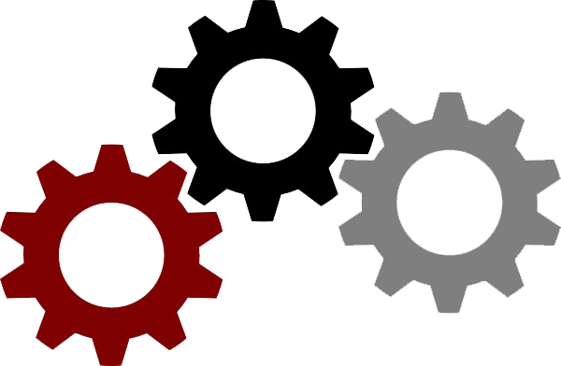
Sustaining and Evaluating Change (2)
How can one perceive an organization?
Machine Metaphor → This produces a clear set of measurable outcomes which can be monitored and evaluated throughout the process. Managing change through this metaphor necessitates a focus on ‘hard’ rather than ‘soft’ aspects of the change, and the expected outcomes may be a little rigid.
Political Metaphor → This metaphor is all about satisfying key stakeholder groupings. Change is a success if key stakeholders are satisfied, and opinions and policies have been changed. The process of change is one of successfully negotiating one’s way through the myriad stakeholder interests.
Organism Metaphor → This metaphor is about ensuring the effectiveness and efficiency of information flow across the organization and its environment. A key aspect of successful change management within this paradigm is the focus on organizational learning and responsiveness.
Flux and Transformation Metaphor → This metaphor is about creating a well-contained space for change to occur. Collective vision and direction, together with a strong sense of organizational values, provide the ‘stakes in the ground’ demarcating parameters for change.

Slide 15
Let’s think!
Question 1: Do you consider different types of change can be managed more effectively by adopting different approaches to change?
Question 2: Reflecting on your personality, in what ways might you be drawn to the different approaches?

Slide 16
Summary
What is the change cycle?
Implementing Change
Which are the steps?
What do we mean by “cyclic nature”?
Which are the success factors?
Needs Assessment Analysis
Evaluating Change
What is it?
What do we need?
How do we conduct it?
How do we evaluate change?
Which are the different paradigm metaphors we can use?

Slide 17
Homework
Evidence suggests that the majority of organizational change plans fail, mostly due to their lack of attention to the basic principles of CM.
You will read a real case study of a failed change plan, implemented by the HRMC.
Having read about how the HMRC has tackled change over the last decade, is there anything you would do differently?

Slide 18
Thank you for your attention! Any questions?
your@email_address.eu

